Slide 1
Identification via other methods
Identification via databases
Additional articles identified through hand searching (n = 24)
Articles identified through Medline Ovid database searching (n = 75)
Articles identified through PubMed database searching (n = 83)
Articles identified through EMBASE database searching (n = 67)
Identification
Articles after duplicates removed (n = 83)
Screening
Articles screened (n = 107)
Articles excluded on title and abstract (n = 30)
Full-text articles excluded, with reasons (n = 29)
Did not assess neutrophils (n = 12)
Did not meet patient inclusion criteria (n = 9)
Published before 1990 (n = 3)
Did not look at changes in neutrophils (n = 3)
Articles not in English (n = 2)
Full-text articles assessed for eligibility (n = 77)
Eligibility
Studies included in qualitative synthesis (n = 48)
Included
Notes:
Figure 1: PRISMA diagram summarising included studies. Further characteristics of each study are available in Table 1.

Slide 2
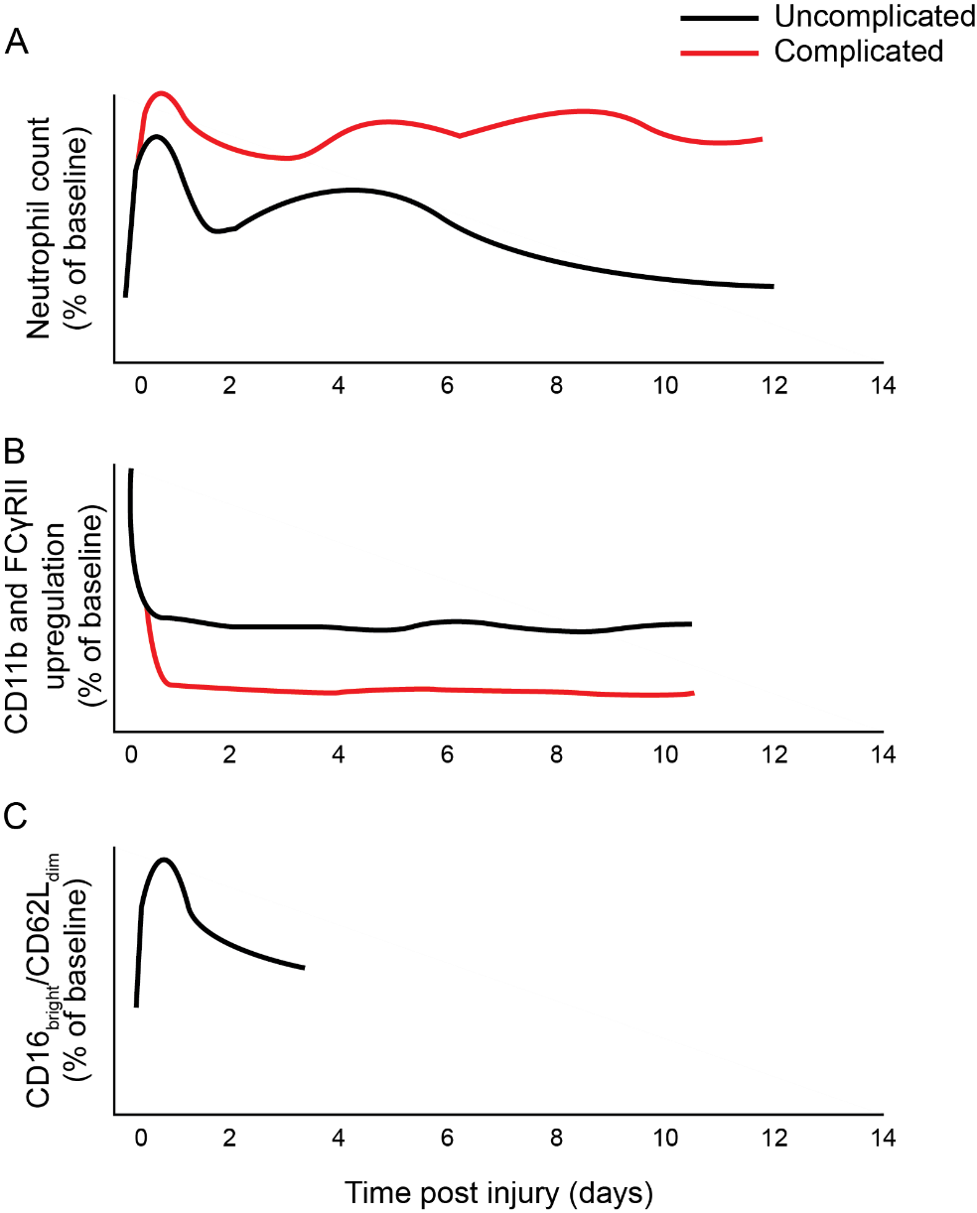
Figure 2: Schematical representation of neutrophil changes over time following major trauma, differentiated by complicated or uncomplicated clinical course. Complicated course indicates subsequent sepsis or multiple organ dysfunction, where evidence exists in the literature.
A: Neutrophil number post injury relative to pre-injury/control levels.
B: Neutrophil responsiveness (CD11b or FCγRII upregulation in response to fMLP) following injury relative to control.
C: Immunosuppressive CD16^{bright}/CD62L^{dim} neutrophils as percentage of total neutrophils relative to control. No data exist for the presence of these cells more than 4 days after trauma or in complicated/uncomplicated courses.
Notes:
Decomposable figure available on next slide

Slide 3
A
Figure 2: Schematical representation of neutrophil changes over time following major trauma, differentiated by complicated or uncomplicated clinical course. Complicated course indicates subsequent sepsis or multiple organ dysfunction, where evidence exists in the literature.
A: Neutrophil number post injury relative to pre-injury/control levels.
B: Neutrophil responsiveness (CD11b or FCγRII upregulation in response to fMLP) following injury relative to control.
C: Immunosuppressive CD16^{bright}/CD62L^{dim} neutrophils as percentage of total neutrophils relative to control. No data exist for the presence of these cells more than 4 days after trauma or in complicated/uncomplicated courses.
Neutrophil count (% of baseline)
B
CD11b and FCγRII upregulation
(% of baseline)
C
CD16_{bright}/CD62L_{dim}
(% of baseline)
Time post injury (days)
Notes:
All parts should be movable on this slide

Slide 4
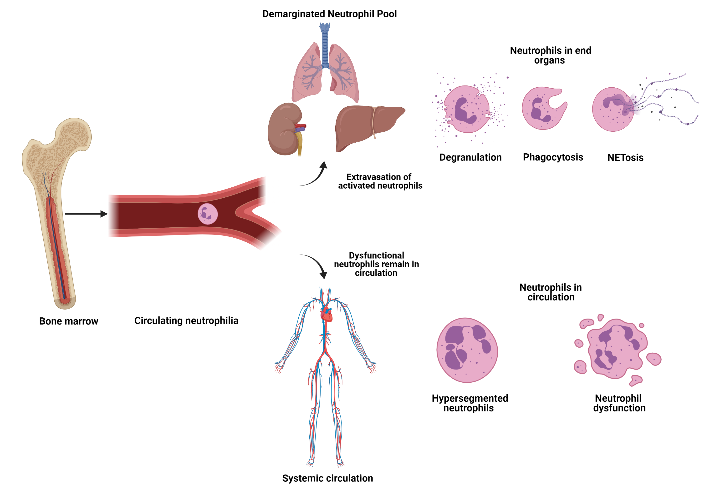
Figure 3: Neutrophil extravasation and resultant immune dysfunction.
Tissue damage caused by injury leads to DAMP, catecholamine and corticosteroid release, which result in neutrophil egress from the bone marrow, as well as increased production through emergency granulopoiesis. This leads to a circulating neutrophilia and altered phenotypes of circulating neutrophils as discussed in text. It is hypothesised that hyperinflammatory cells expressing high levels of adhesion markers transmigrate into the demarginated pool in the lungs, spleen, liver and other end organs, where they may cause further inflammation through NETosis, degranulation and phagocytosis, leading to organ dysfunction. The loss of these highly inflammatory cells from the circulation leads to remaining neutrophils being dysfunctional, predisposing the individual to immune failure and secondary infection.
Figure created with BioRender.com
Notes:
Decomposable figure on next slide

Slide 5
Demarginated neutrophil pool
Neutrophils in end organs
Degranulation
Phagocytosis
NETosis
Extravasation of activated neutrophils
Dysfunctional neutrophils remain in circulation
Circulating neutrophilia
Neutrophils in circulation
Bone marrow
Hypersegmented neutrophils
Neutrophil dysfunction
Systemic circulation
Notes:
Figure 3: Neutrophil extravasation and resultant immune dysfunction.
Tissue damage caused by injury leads to DAMP, catecholamine and corticosteroid release, which result in neutrophil egress from the bone marrow, as well as increased production through emergency granulopoiesis. This leads to a circulating neutrophilia and altered phenotypes of circulating neutrophils as discussed in text. It is hypothesised that hyperinflammatory cells expressing high levels of adhesion markers transmigrate into the demarginated pool in the lungs, spleen, liver and other end organs, where they may cause further inflammation through NETosis, degranulation and phagocytosis, leading to organ dysfunction. The loss of these highly inflammatory cells from the circulation leads to remaining neutrophils being dysfunctional, predisposing the individual to immune failure and secondary infection.
Figure created with BioRender.com

Slide 6
Image credits
Figure 3 created with BioRender.com

