Slide 1
A
B
RA
RA
RV
RV
Notes:
58628115

Slide 2
Notes:
Figure 2: Prevalence of causative organisms according to timing and technique of valve intervention.

Slide 3
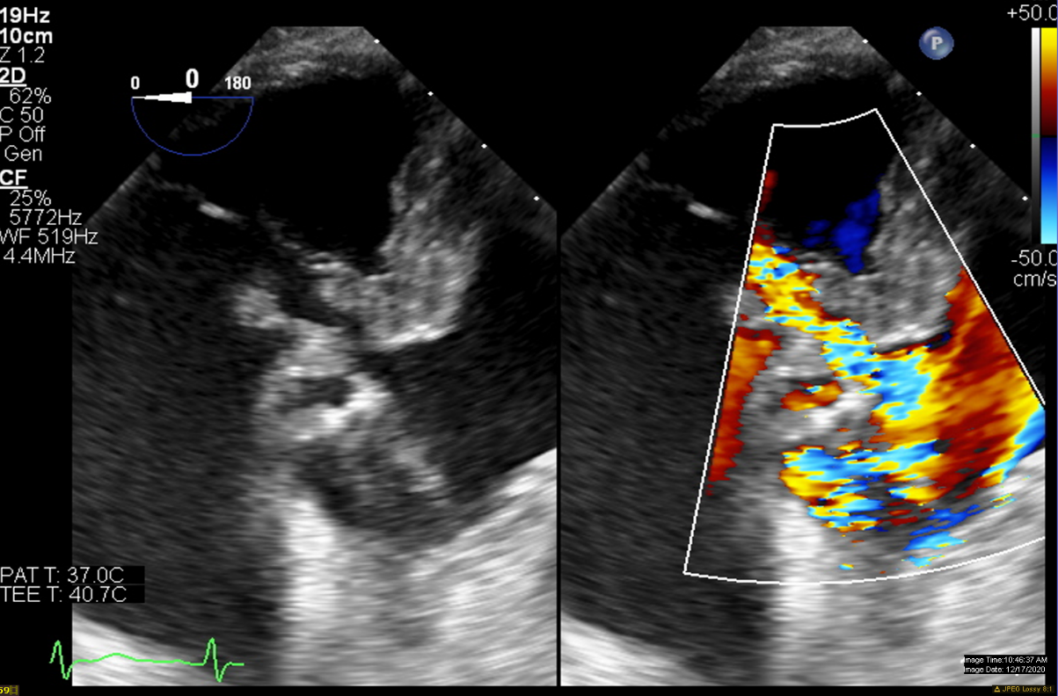
A
B
RA
RA
RV
RV
C
D
RA
RA
LVOT
LVOT
Notes:
Figure 3: Perivalvular complication in a patient with stentless aortic valve endocarditis.

Slide 4
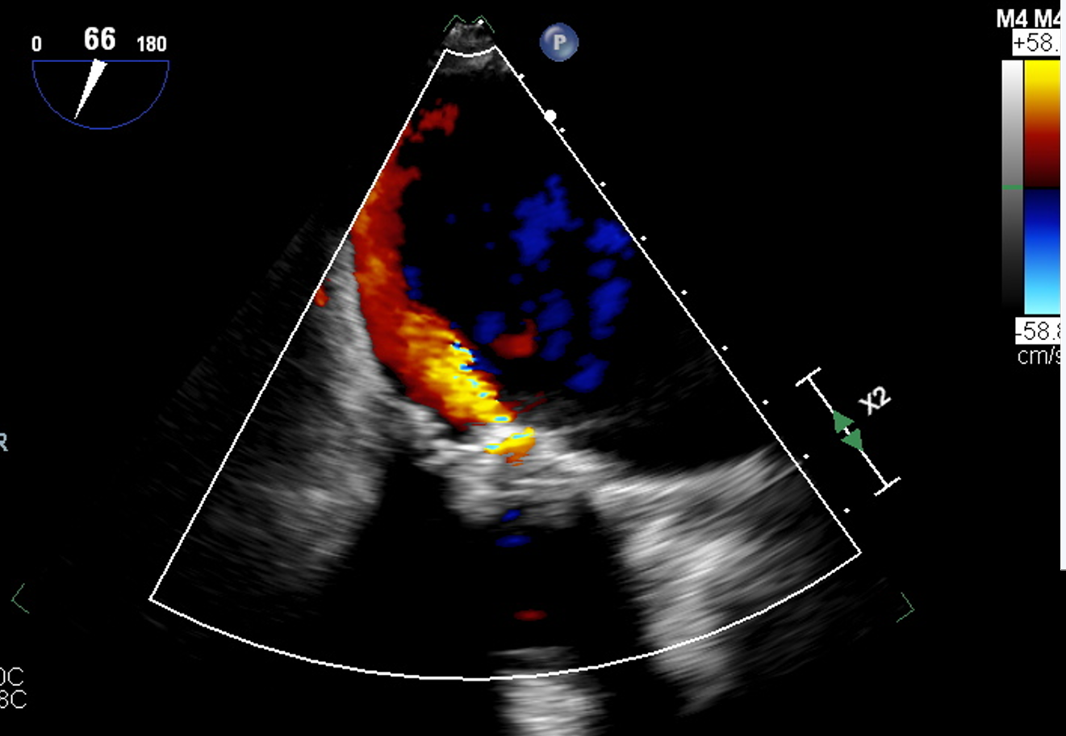
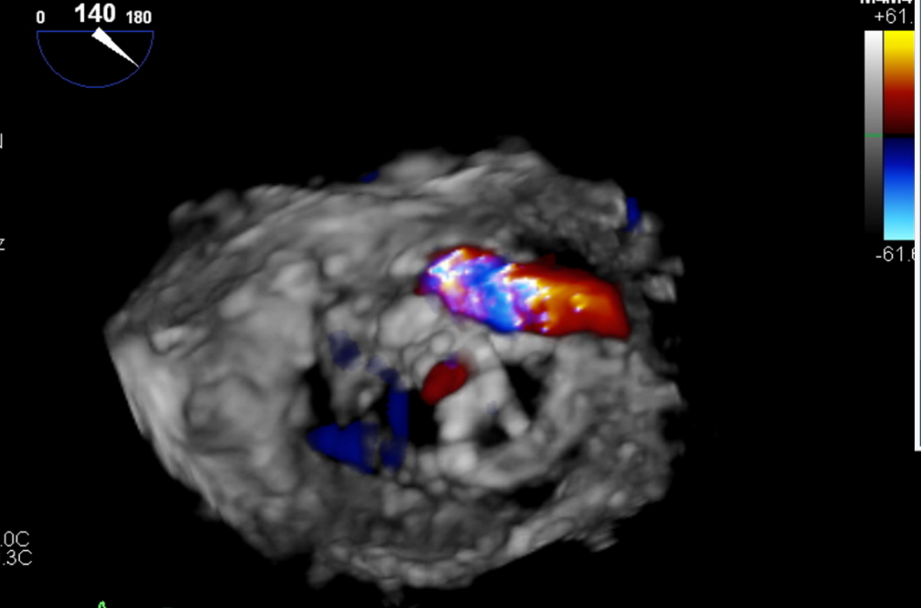
A
B
C
C
D
Notes:
Figure 4: Transesophageal echocardiogram in a patient with mitral valve replacement endocarditis with 3D-reconstruction.

Slide 5
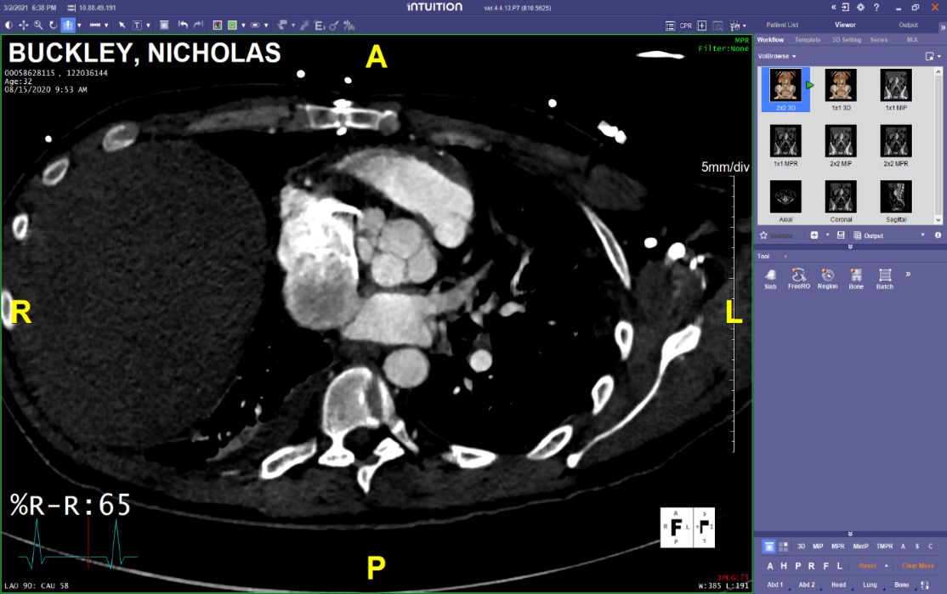
A
B
C
Notes:
Figure 5: Cardiac Computed tomography in a patient with tricuspid valve replacement endocarditis with perivalvular extension.

Slide 6
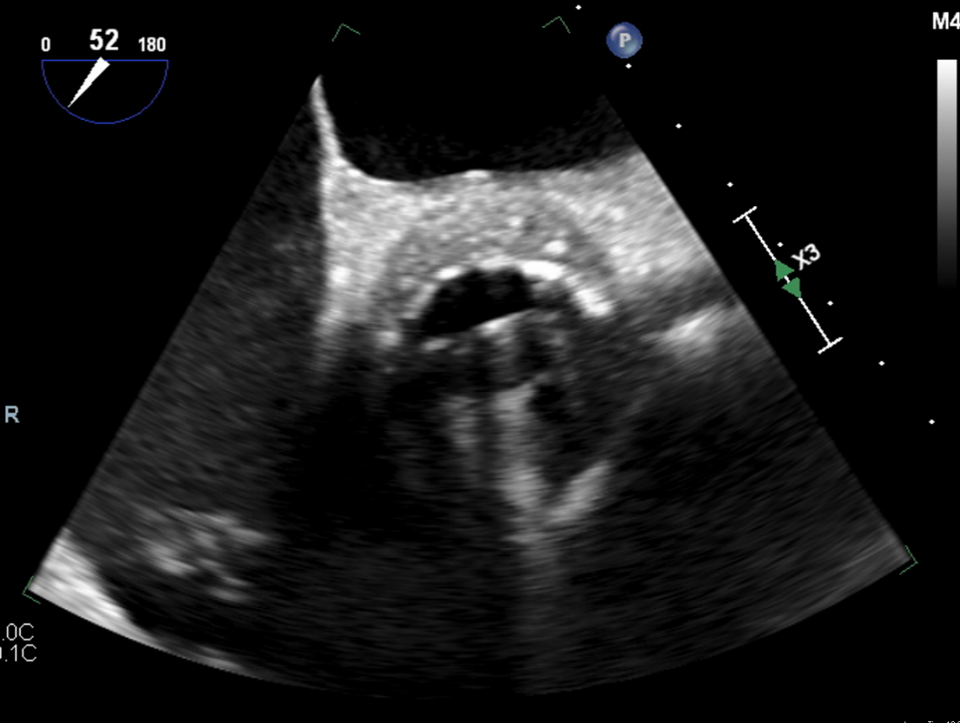
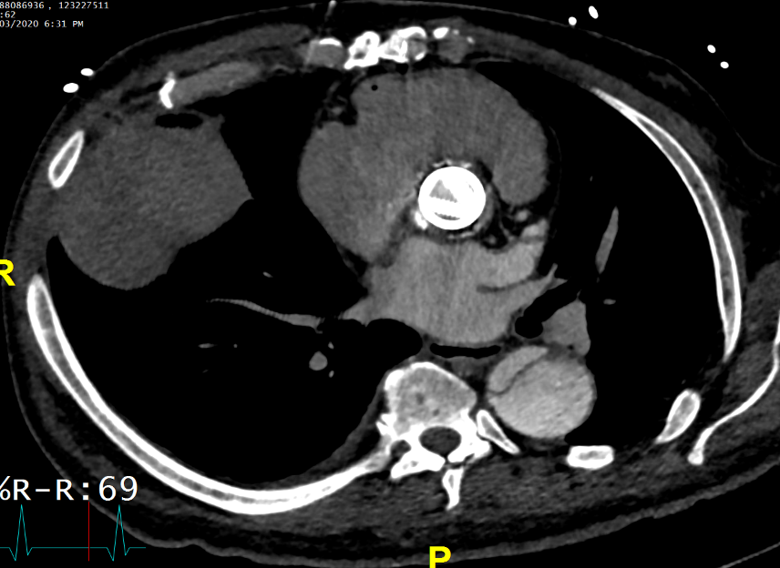
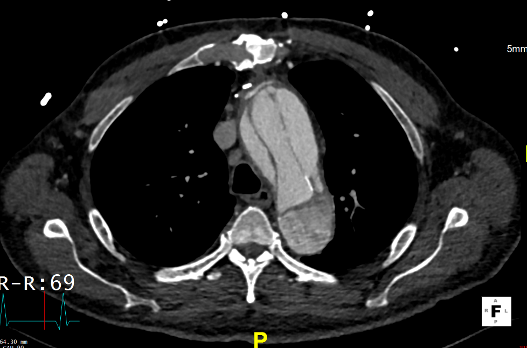
LA
LA
A
B
RA
LV
RV
C
D
Notes:
Figure 6: Tranesophageal echocardiogram and cardiac computed tomography in a patient with metallic aortic valve replacement endocarditis, complicated by aortic dissection.

Slide 7
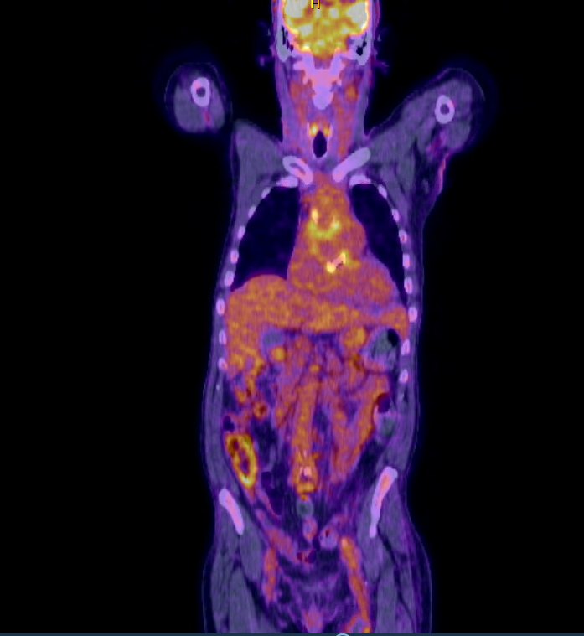
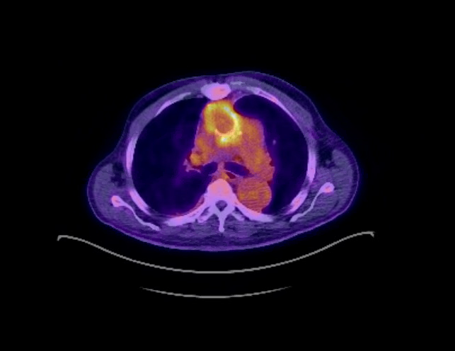
A
B
C
D
Notes:
Figure 7: ¹⁸F-FDG PET/CT in a patient with aortic valve replacement complicated by septic emboli.

