Slide 1
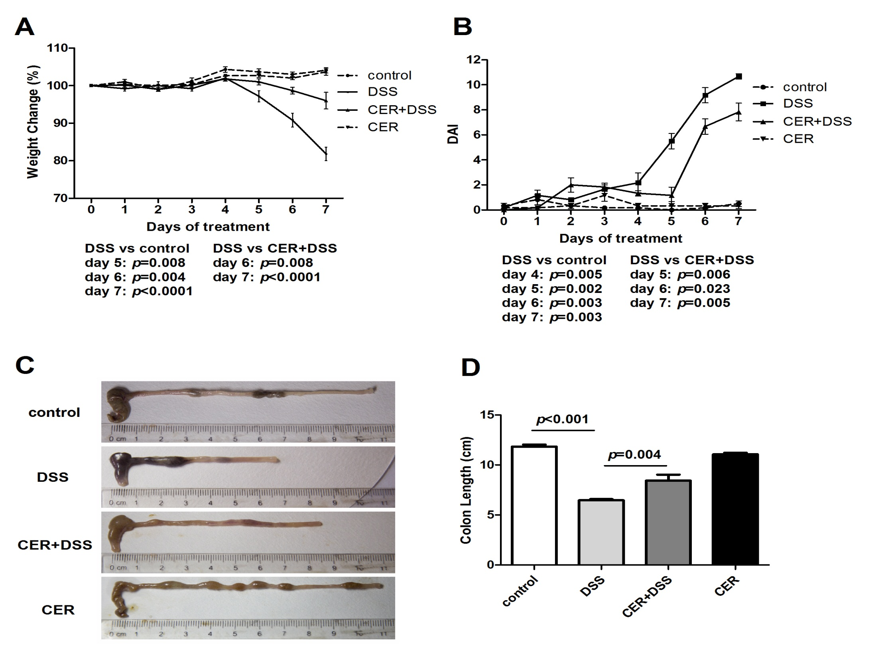

Slide 2
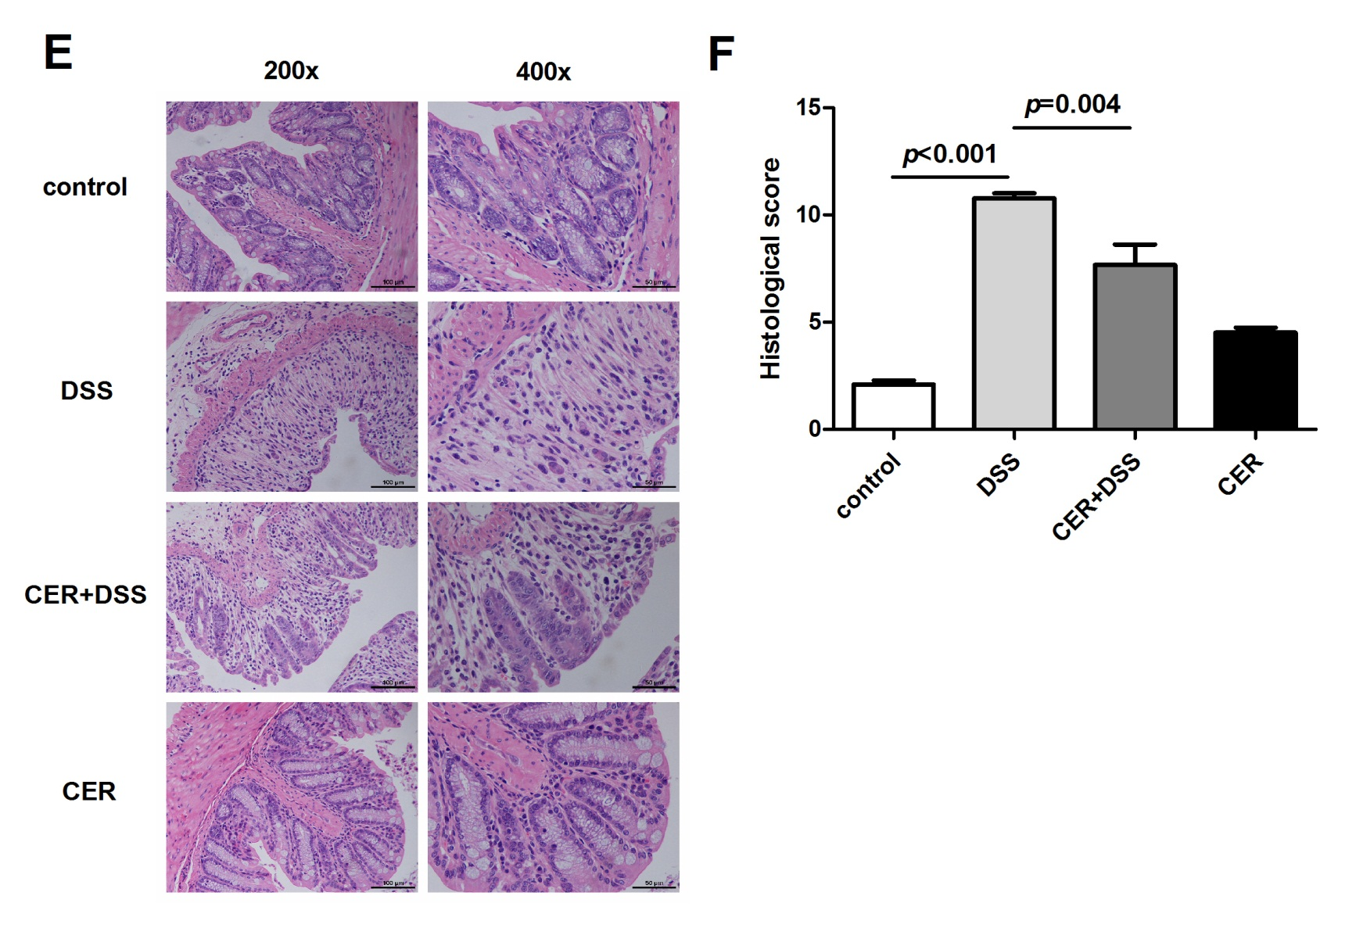

Slide 3
Fig. 1. Treatment with S. japonicum cercariae resulted in reduced susceptibility to DSS-induced colitis in mice. Mice were infected with 20±2 S. japonicum cercariae percutaneously, and experimental colitis was induced by administration of 3% DSS at 4 weeks post infection. (A) Weight change in percent. (B) DAI was based on weight change, stool characteristics and bleeding. (C) and (D) show colon length. (E) H&E staining was performed in colonic sections (original magnification, 200× and 400×). (F) HS was scored as described in Materials and Methods. n=6. DSS: dextran sodium sulfate treatment group; CER+DSS: infection with S. japonicum before DSS treatment group; CER: S. japonicum infection group. The mice infected with S. japonicum cercariae presented longer colons, decreased weight loss and lower DAI and HS after being induced with DSS compared to those without parasite infection.

Slide 4
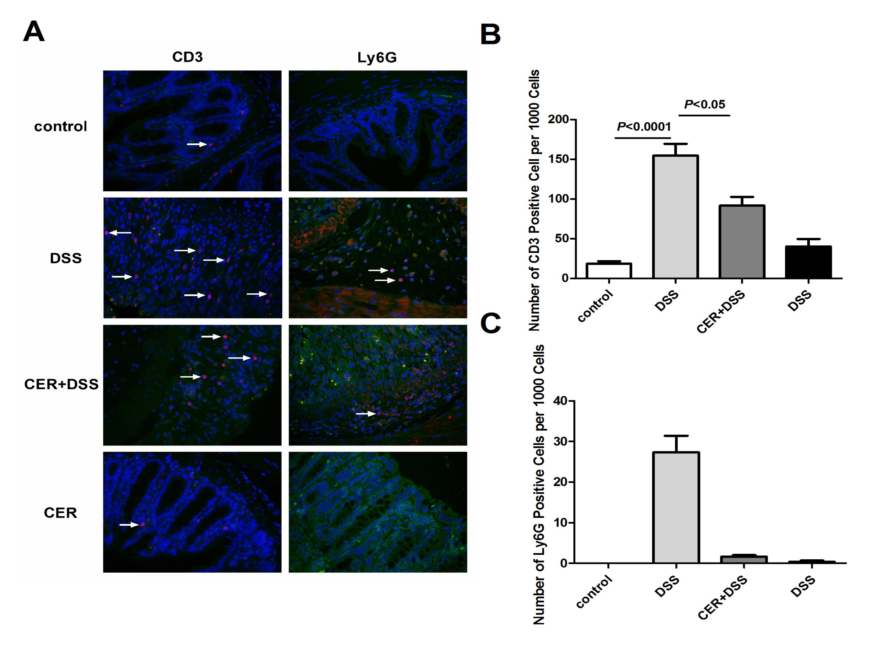

Slide 5
Fig. 2. Infection with S. japonicum decreased infiltration of inflammatory cells in colon tissues. (A) Immunofluorescence staining of CD3 and Ly6G in the colon sections. (B) and (C) respectively show quantification of CD3 and Ly6G positive cells. n=3 or 4. DSS: dextran sodium sulfate treatment group; CER+DSS: infection with S. japonicum before DSS treatment group; CER: S. japonicum infection group.

Slide 6
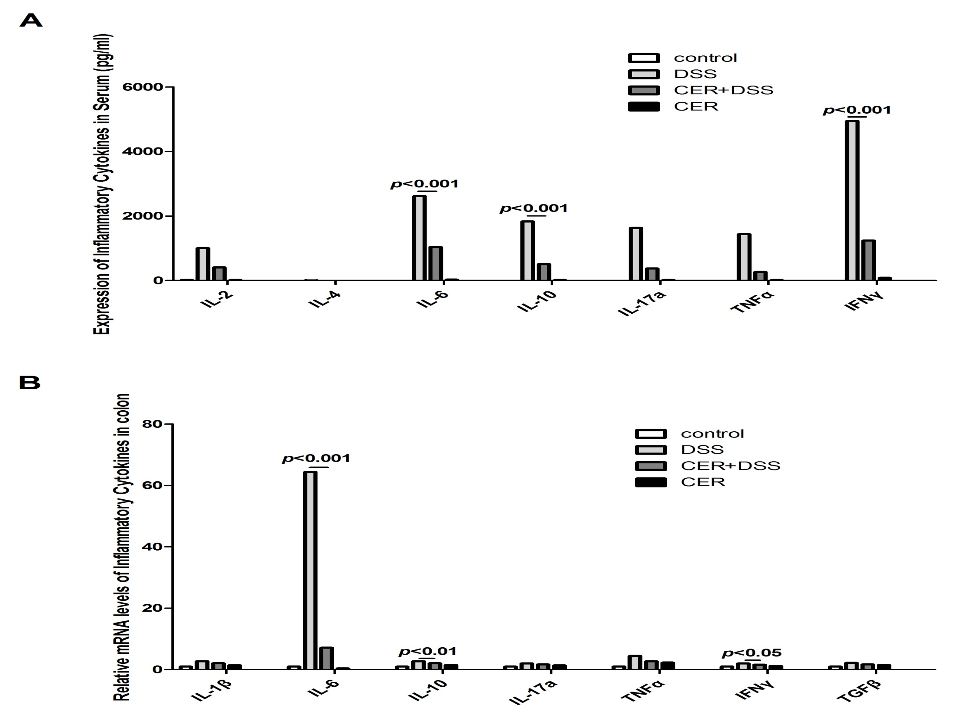

Slide 7
Fig. 3. Administration of S. japonicum led to lowered inflammatory cytokines in DSS-induced colitis mice. (A) The production of IL-2, IL-6, IL-10, IL-17A, TNF and IFNγ in blood samples was detected by CBA and flow cytometry. n=4. (B) IL-1β, IL-6, IL-10, IL-17a, IFNγ, TNFα and TGFβ levels in colon tissues were tested by RT-PCR. n=3. DSS: dextran sodium sulfate treatment group; CER+DSS: infection with S. japonicum before DSS treatment group; CER: S. japonicum infection group. Exposure to S. japonicum protected mice from DSS-induced colitis with down-regulation of the Th1/Th2/ Th17 pathways.

Slide 8
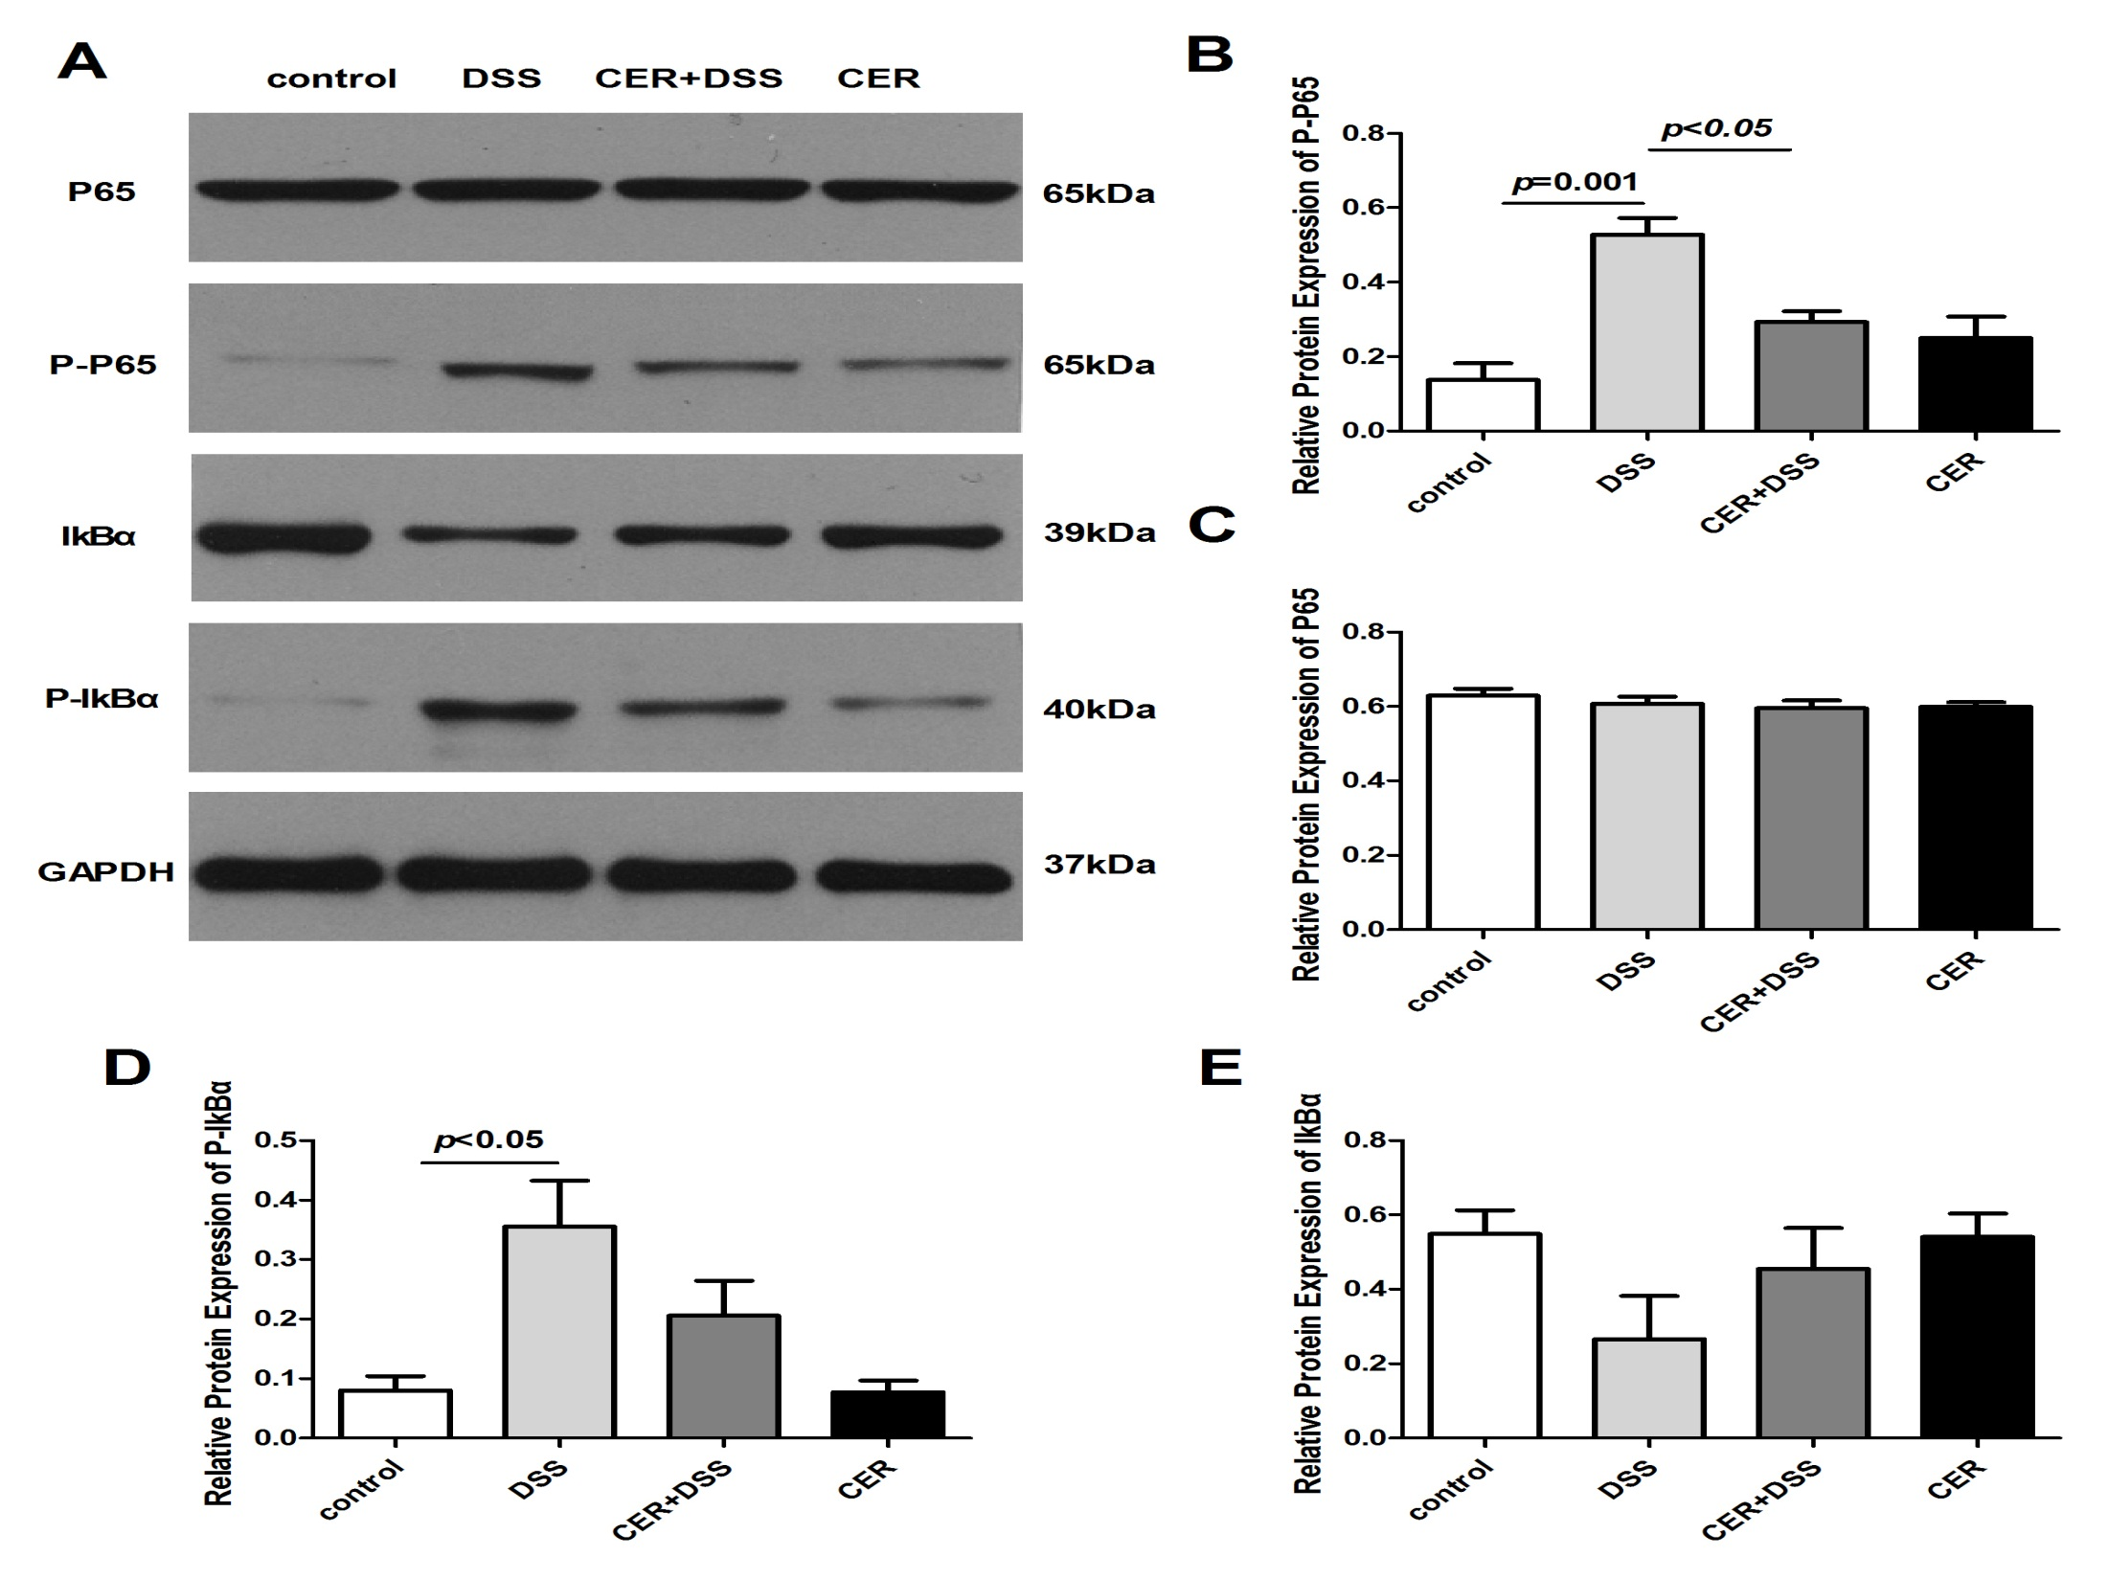

Slide 9
Fig. 4. Infection with S. japonicum decreased the expression of phosphorylated-p65 (P-P65) in mice treated with DSS. (A) The expression of P-P65 and P65 in colon tissues was examined by Western blotting. (B-C) Respective quantification of P-P65 and P65. n=3 or 4. DSS: dextran sodium sulfate treatment group; CER+DSS: infection with S. japonicum before DSS treatment group; CER: S. japonicum infection group.

Slide 10
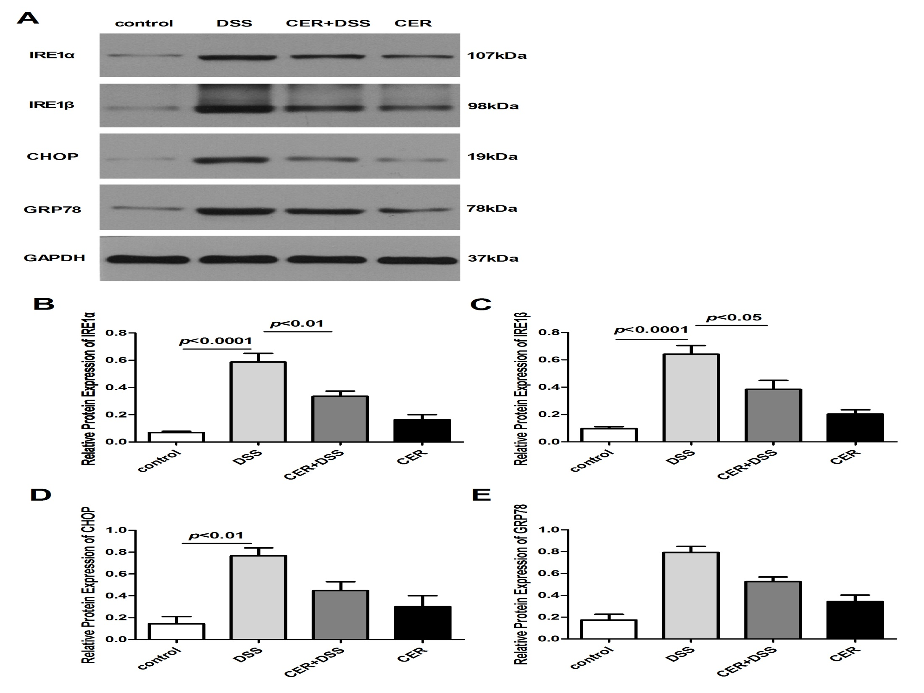

Slide 11
Fig. 5. Endoplasmic reticulum stress markers were downregulated in mice induced by DSS after infection. (A) The expression of IRE1α, IREβ, GRP78 and CHOP in colon tissues was examined by Western blotting. (B-E) Respective quantification of IRE1α, IREβ, GRP78 and CHOP. n=4. DSS: dextran sodium sulfate treatment group; CER+DSS: infection with S. japonicum before DSS treatment group; CER: S. japonicum infection group.

Slide 12
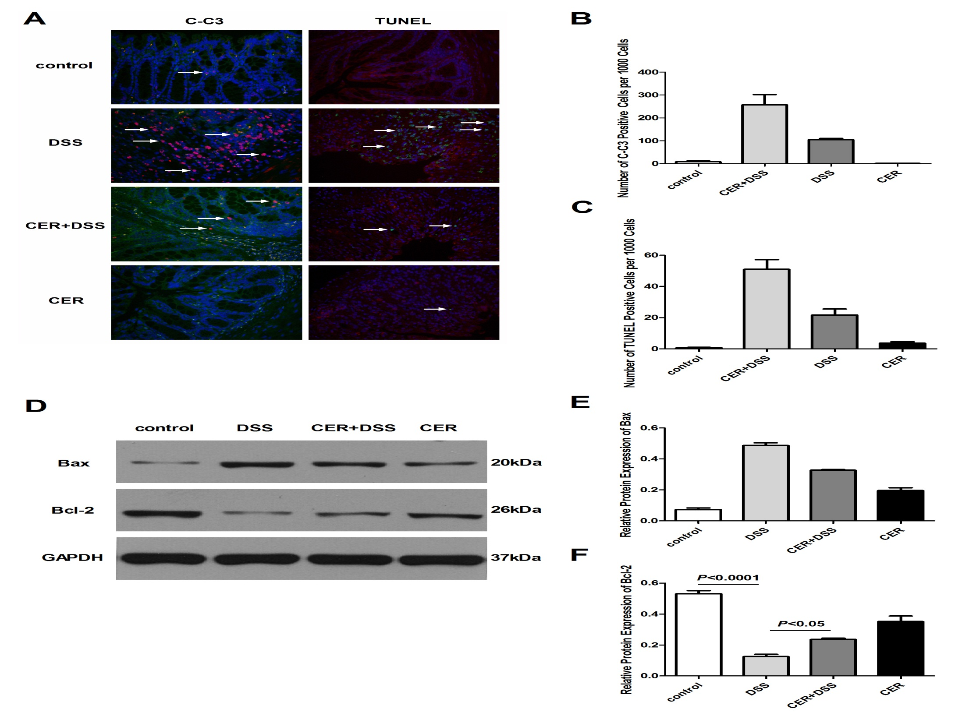

Slide 13
Fig. 6. Decreased enterocytes apoptosis was observed in colitic mice after infection with S. japonicum. (A) Immunofluorescence staining was used to detect cleaved-caspase3 (C-C3) and TUNEL. (B-C) Respective quantification of C-C3 and TUNEL positive cells. (D) Bax and Bal-2 were tested by Western blotting. (E-F) Respective quantification of Bax and Bal-2. n=3. DSS: dextran sodium sulfate treatment group; CER+DSS: infection with S. japonicum before DSS treatment group; CER: S. japonicum infection group.

Slide 14
Table 1 Disease activity index score parameters (DAI)
Score | Body weight loss (%) | Stool consistency | Rectal bleeding
0 | 0-1 | Normal | None
1 | 1-5 | Soft and shaped | Between
2 | 5-10 | Loose | Slight
3 | 10-15 | Between | Between
4 | >15 | Diarrhea | Gross bleeding

Slide 15
Table 2 Histological scoring system used in this study
Score | Damaged area | Mucodepletion of glands | Tissue damage | Inflammatory cell infiltration
0 | N/A | None | No mucosal damage | Occasional inflammatory cells in the lamina propria
1 | ≤25% | Mile | Discrete epithelial lesions | Increased numbers of inflammatory cells in the lamina propria
2 | ≤50% | Moderate | Surface mucosal erosion or focal ulceration | Confluence inflammatory cells, extending into the submucosa
3 | ≤75% | Moderate | Extensive mucosal damage and extension into deeper structures of the bowel wall | Transmural extension of the infiltrate
4 | ≤100% | Severe

Slide 16
Table 3 The gene-specific primer pairs used in the study.
Primer names |  | Primer sequences | Product lengths（bp）
M-GAPDH | Forward | 5`-TGAAGGGTGGAGCCAAAAG-3` | 227
 | Reverse | 5`-AGTCTTCTGGGTGGCAGTGAT-3`
M-IL-6 | Forward | 5`-CTTCTTGGGACTGATGCTGGT-3` | 171
 | Reverse | 5`-CACAACTCTTTTCTCATTTCCACG-3`
M-IL-10 | Forward | 5`-TACAGCCGGGAAGACAATAACT -3` | 142
 | Reverse | 5`- AGGAGTCGGTTAGCAGTATGTTG-3`
M-TNF-α | Forward | 5`-TCCCCAAAGGGATGAGAAGTT-3` | 298
 | Reverse | 5`-GAGGAGGTTGACTTTCTCCTGG-3`
M-TGF-β | Forward | 5`-AGAGCCCTGGATACCAACTATTG-3` | 286
 | Reverse | 5`-TGCGACCCACGTAGTAGACG-3`
M-IFN-γ | Forward | 5`-CTCAAGTGGCATAGATGTGGAAG-3` | 250
 | Reverse | 5`-GACCTCAAACTTGGCAATACTCA-3`
M-IL-1b | Forward | 5`-GGGCCTCAAAGGAAAGAATCT-3` | 195
 | Reverse | 5`-GAGGTGCTGATGTACCAGTTGG-3`
M-IL-17a | Forward | 5`-GTCTTTAACTCCCTTGGCGC-3` | 136
 | Reverse | 5`-GGCACTGAGCTTCCCAGATC-3`
M-IRE1a | Forward | 5`-ACACACCGACCACCGTATCTC-3` | 157
 | Reverse | 5`-GGGTAAGTGATGATGAACGCC-3`
M-IRE1b | Forward | 5`-TGGACGGTCCCACAACAGAT-3` | 140
 | Reverse | 5`-GGGAGGTTCGTGGTATCCAA-3`
M-GRP78 | Forward | 5`-GATGAAATTGTTCTGGTTGGTGG-3` | 203
 | Reverse | 5`-AGTGTAAGGGGACAAACATCAAG-3`
M-CHOP | Forward | 5`-GGAGCTGGAAGCCTGGTATG-3` | 285
 | Reverse | 5`-GGGCACTGACCACTCTGTTTC-3`

