Slide 1
Figure 1
A
B
1.5
30000
25000
1.0
20000
Relative expression of miR-382
Relative expression of miR-382
15000
5
0.5
4
3
a
2
0
1
Het-1A
Eca109
0
LV-Con
LV-miR-382

Slide 2
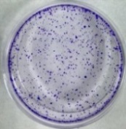
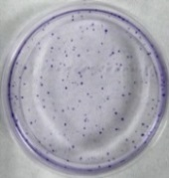
Figure 2
A
B
C
400
LV-Con
LV-Con
LV-miR-382
500
300
400
Relative cell growth rate
300
200
Cell number
LV-miR-382
200
a
100
a
100
0
0 h
0
36 h
72 h
LV-Con
LV-miR-382

Slide 3
Figure 3
A
B
LV-Con
LV-miR-382
G1: 61.09%
G1: 36.69%
320
120
Counts
240
S: 26.36%
Counts
90
S:36.71%
160
60
G2/M:26.6%
80
G2/M: 12.55%
30
0
0
FL2-A
FL2-A
C
D
250
LV-Con
a
LV-miR-382
LV-miR-382
200
LV-Con
150
Relative cell distribution(%)
p21Cip1/Waf1
100
50
β-actin
0
G1
S
G2/M

Slide 4
Figure 4
A
B
LV-Con
LV-miR-382
20
LV-Con
LV-miR-382
UR
4.49%
UR
24.73%
15
b
10
Cell proportion(%)
PI
LR
1.07%
LR
16.99%
a
5
0
UR
LR
Annexin V-FITC

Slide 5
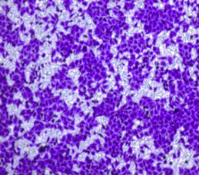
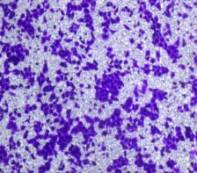
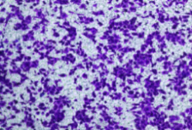
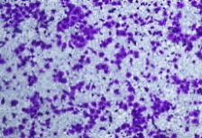
Figure 5
A
B
E
800
LV-Con
600
Cell number
LV-miR-382
400
a
LV-Con
LV-miR-382
200
0
E-Cadherin
LV-Con
LV-miR-382
C
D
β-Catenin
LV-Con
500
Vimentin
400
b
Cell number
300
Snail
200
LV-miR-382
100
β-actin
0
LV-Con
LV-miR-382

Slide 6
Figure 6
LV-miR-382
LV-Con
p-mTOR
mTOR
p-4EBP1
LC3-Ι
LC3-Π
β-actin

