Slide 1
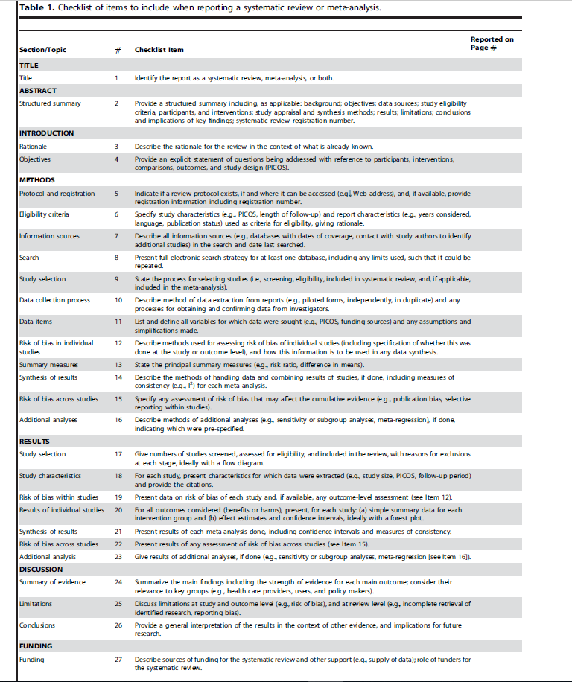
Page 1
Page 3/4
Pages 5–6
Page 6
Page 7
Pages 7–8
Page 7
Pages 7–8
Page 8
Page 8
Page 8
Page 9
Page 8
NA
Page 9
NA
Page 9 and Fig 2
Page 10 and Table 1
Page 10/11 and Table 2
Page 9–13
NA
NA
NA
Pages 13–18
Page 17
Page 17
Page 18

