Slide 1
Records identified through databases: PubMed, Cochrane,
Embase, CNKI, VIP, WF: N= 501
Literature obtained through
other sources:
N = 0
Identification
Records after duplicates were
removed by EndNote:
N = 345
Screening
Records screened out after reading titles and abstracts: non-randomized control trials, case reports, reviews, animal studies, mechanism studies, protocol: N=314
Eligibility
Full-text articles assessed for eligibility: N = 31
Final inclusion articles in quantitative synthesis
(meta-analysis): N=10
Full-text articles do not fully fulfill the inclusion criteria or were duplications: N=21
Inclusion
Figure 1 Flow diagram of included studies in the meta-analysis(up to April 2018)

Slide 2
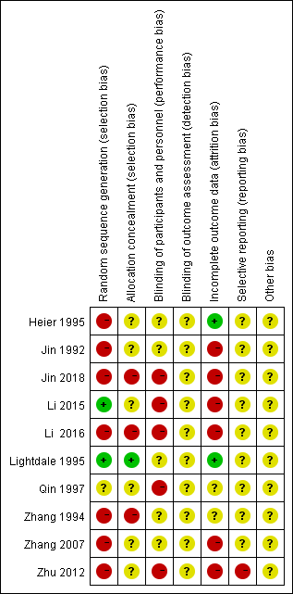
Figure 2 Risk of bias summary: review authors’ judgements regarding risk of bias item for each included study.

Slide 3
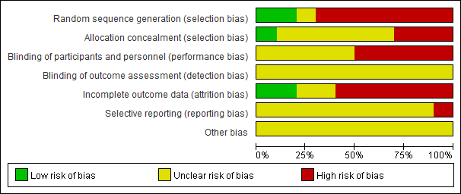
Figure 3 Risk of bias graph: review authors’ judgements regarding risk of bias items presented as percentages across all included studies.

Slide 4
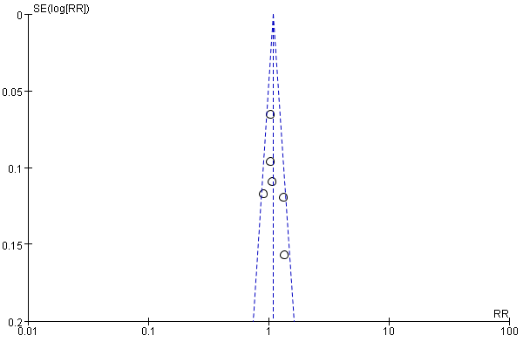
Figure 4 The funnel plot of the significant remission rate between PDT combined with chemotherapy and PDT/Chemotherapy discussion in middle-advanced upper gastrointestinal carcinoma.

Slide 5
Figure 5 Forest plot of the risk ratio (RR) for the significant remission rate associated with middle-advanced stage upper gastrointestinal carcinomas. Notes: the box represents the RR point estimate of each study, and its area is proportional to the weight of the estimate. Horizontal lines represent the 95% confidence interval (CI).

Slide 6
Figure 6 Forest plot of the risk ratio (RR) for the effective rate associated with middle-advanced stage upper gastrointestinal carcinomas. Notes: the box represents the RR point estimate of each study, and its area is proportional to the weight of the estimate. Horizontal lines represent the 95% confidence interval (CI).

Slide 7
Figure 7 Forest plot of the risk ratio (RR) for the significant remission rate associated with middle-advanced stage upper gastrointestinal carcinomas. Notes: the box represents the RR point estimate of each study, and its area is proportional to the weight of the estimate. Horizontal lines represent the 95% confidence interval (CI).

Slide 8
Figure 8 Forest plot of the risk ratio (RR) for the effective rate associated with middle-advanced stage upper gastrointestinal carcinomas. Notes: the box represents the RR point estimate of each study, and its area is proportional to the weight of the estimate. Horizontal lines represent the 95% confidence interval (CI).

Slide 9
Figure 9 Forest plot of the risk ratio (RR) for the One-year survival rate associated with middle-advanced stage
upper gastrointestinal carcinomas. Notes: the box represents the RR point estimate of each study, and its area is proportional to the weight of the estimate. Horizontal lines represent the 95% confidence interval (CI).

