Slide 1
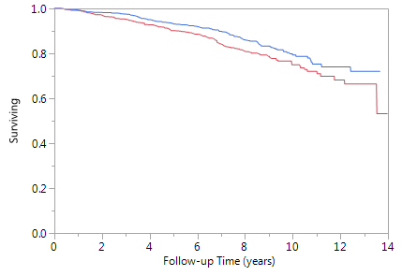
Legend
≥ Median RHR(66bpm)
< Median RHR
All-Cause Mortality
Log-rank P = 0.0223
Figure 1A: Kaplan Meier curves showing the Mortality free- survival of Type- Diabetics with resting heart rate(RHR) above and below the median ( Median RHR=69 bpm) in the Diabetes Heart Study

Slide 2
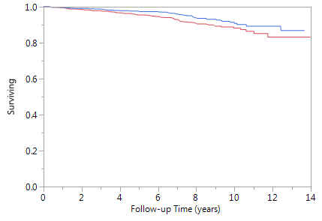
Legend
≥ Median RHR(66bpm)
< Median RHR
Cardiovascular Disease Mortality
Log-rank P = 0.0451
Figure 1B: Kaplan Meier curves showing the Cardiovascular disease Mortality free- survival of Type- Diabetics with resting heart rate(RHR) above and below the median ( Median RHR=69 bpm) in the Diabetes Heart Study

