Slide 1
Table 1 Primer sequences for RT-PCR
Gene | Sequences (forward/reverse 5’-3’)
rGAPDH | Sense: 5’-CCATCAACGACCCCTTCATT-3’
 | Antisense: 5’-GACCAGCTTCCCATTCTCAG-3’
rSERT | Sense: 5’-ACTGTTACCAAGATGCCCTG-3’
 | Antisense: 5’-ATCTTCATTCCTCATCTCCGC-3’
rGAPDH, rat glyceraldehyde-3-phosphate dehydrogenase; rSERT, rat serotonin transporter.

Slide 2
Adult male SD rat (n=110)
PBS gavage 2ml/d, 7d
C. Jejuni gavage 2ml/d, 7d
Control group n=25
PI-IBS model group n=85
One died with gavage trauma
Model evaluation
(control group n=5; PI-IBS group n=4, randomly)
Undiluted LGG-s
gavage 2ml/d
Double diluted LGG-s
gavage 2ml/d
Triple diluted LGG-s
gavage 2ml/d
PBS gavage 2ml/d
PBS gavage 2ml/d
Control group
(M, n=20)
PI-IBS PBS group
(A, n=20)
PI-IBS LGG-s group
(B, n=20)
PI-IBS LGG-s group
(C, n=20)
PI-IBS LGG-s group
(D, n=20)
Figure 1 Experimental flow chart.

Slide 3
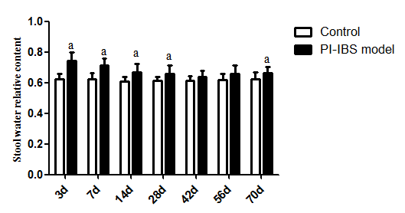
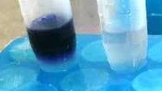
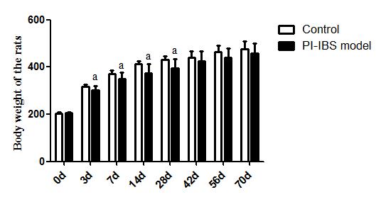
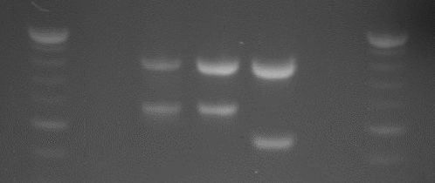
A
C
C-1
C-3
C-2
C-4
B
C-5
a
b
c
d
e
f
Figure 2 Assessment of Campylobacter Colonization Phase.

Slide 4
Figure 2 Assessment of Campylobacter Colonization Phase.
A: Stool water relative content during the observation period, ª P<0.05 VS control group;
B: Body weight of rats during the observation period, ª P<0.05 VS control group;
C: C-1 catalase test; C-2 3-indoylacetate hydrolysis test; C-3 hippurate hydrolysis test;
C-4 oxidase test; C-5 DNA agarose gel electrophoresis,
a for negative simple,
b for positive simple,
c for positive quality control of Campylobacter jejuni,
d for positive quality control of Campylobacter coli,
e for negative quality control, f for DNA ladder.
Control group n=25; PI-IBS group n=84.

Slide 5
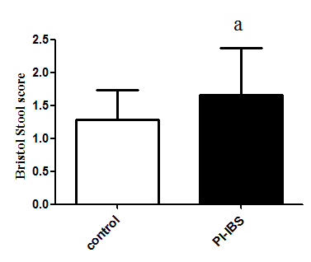
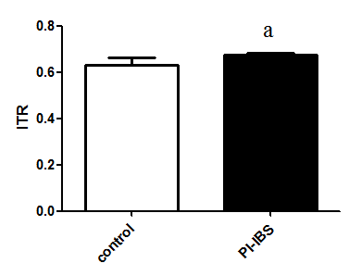
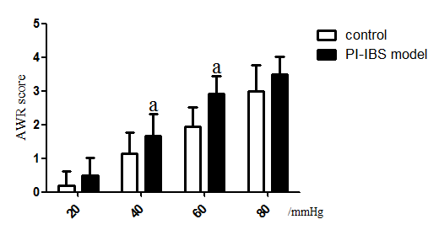
A
B
C
Figure 3 Assessment of PI-IBS Phase. A: Bristol Stool score of Bristol Stool score, ª P<0.05 VS control group; B: Intestinal transit rate by activated carbon solution, ITR = length of the activated carbon moving in the bowel (cm) / length of the whole bowel (cm), ª P<0.05 VS control group; C: AWR scores at different pressure, ª P<0.05 VS control group. Control group n=5; PI-IBS group n=4.

Slide 6
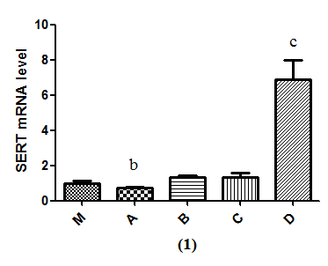
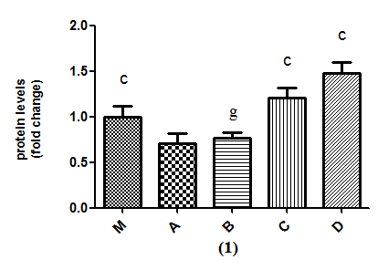
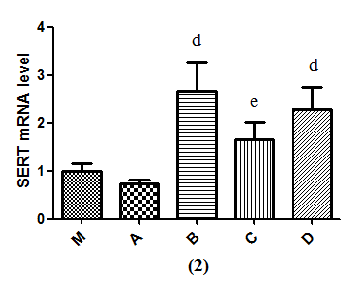
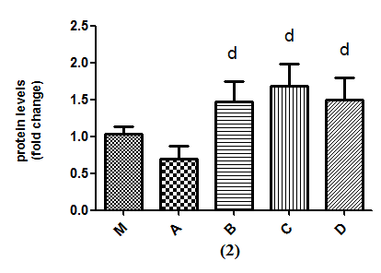
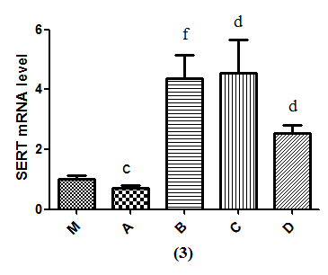
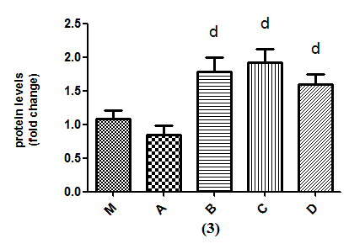
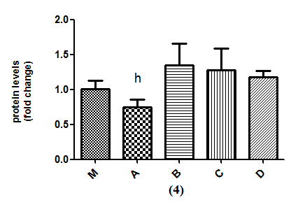
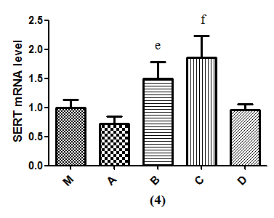
A
B
C
SERT
β-actin
M A B C D
(1)
SERT
β-actin
M A B C D
(2)
SERT
β-actin
M A B C D
(3)
SERT
β-actin
M A B C D
(4)

Slide 7
Figure 4 Effects of LGG-s on SERT mRNA and SERT-P expression in rat intestinal tissues. A: Form up to down represent the SERT mRNA level at the first, second, third and fourth week; B: Form up to down represents the SERT-P level at the first, second, third and fourth week analyzed by Western blot; C: Form up to down represents the quantitative analysis of SERT-P level at the first, second, third and fourth week analyzed by Western blot.
^{b} P<0.05 VS B or C; ^{c} P<0.05 VS all others; ^{d} P<0.05 VS M or A; ^{e} P<0.05 VS A; ^{f} P<0.05 VS M, A or D; ^{g} M, C or D; ^{h} P<0.05 VS M or D. Control group n=5; PI-IBS group n=5, each week.

Slide 8
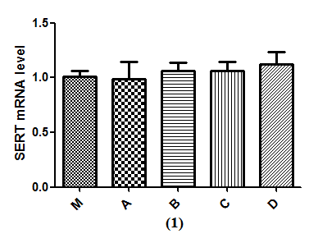
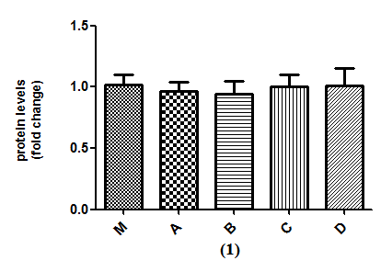
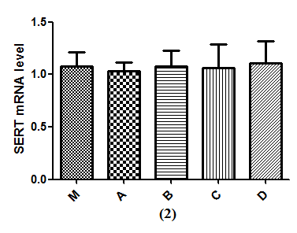
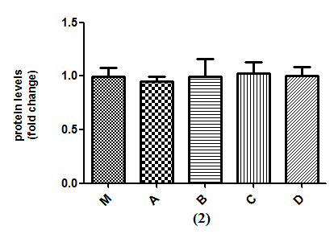
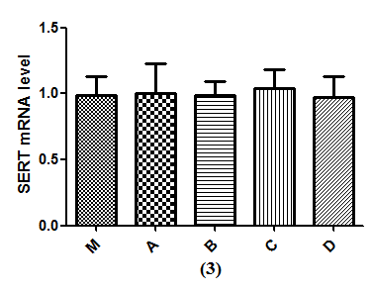
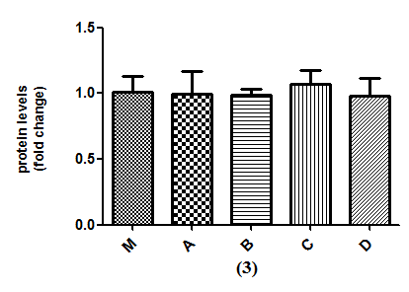
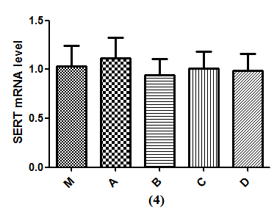
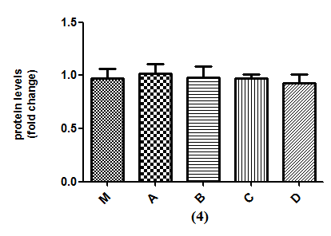
A
B
C
SERT
β-actin
M A B C D
(1)
SERT
β-actin
M A B C D
(2)
SERT
β-actin
M A B C D
(3)
SERT
β-actin
M A B C D
(4)

Slide 9
Figure 5 Effects of LGG-s on SERT mRNA and SERT-P expression in rat brain tissues. A: Form up to down represent the SERT mRNA level at the first, second, third and fourth week; B: Form up to down represents the SERT-P level at the first, second, third and fourth week analyzed by Western blot; C: Form up to down represents the quantitative analysis of SERT-P level at the first, second, third and fourth week analyzed by Western blot. Control group n=5; PI-IBS group n=5, each week.

