Slide 1
Serrated polyps
HPs
SSAs
TSAs
MPs
MVHPs
GCHPs
MPHPs
KRAS mutations are frequently present
BRAF mutations are frequently present
Possible evolution

Slide 2
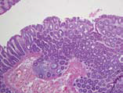
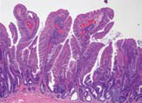
Serrated polyp type | MVHP | GCHP
Morphology | Few larger polyps | Many smaller polyps
Preferential location | Right colon | Left colon
CIMP-H phenotype (%) | 41–73 | 8-18
MSI (%) | No reported | 8
BRAF mutation (%) | 67–88 | 20–83
KRAS mutation (%) | 6–17 | 8–73

Slide 3
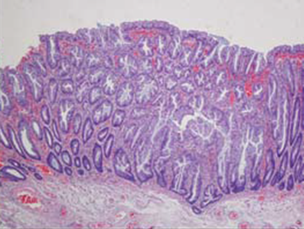
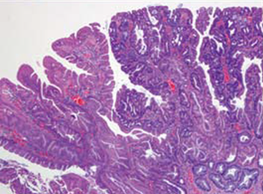
Serrated polyp | SSA | TSA
Prevalence (%) | 10–25 | 1-2
Preferential location | Right colon | Left colon
CIMP-H phenotype (%) | 44-77 | 43–80
MSI (%) | Rarely observed | 3
BRAF mutation (%) | 32–83 | 60–76
KRAS mutation (%) | 7–25 | 0–28

Slide 4
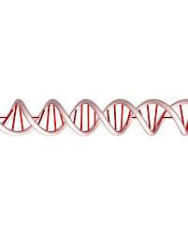
EGF/other activators
Pi
SHC
GRB2
SOS1
RAS GDP
RAS GTP
Pi
P
Raf-1
Raf-1
Pi
PROLIFERATION
P
MEK1/2
MEK1/2
Pi
ADHESION
P
ERK1/2
ERK1/2
INVASION
METASTASIS
ANGIOGENESIS

Slide 5
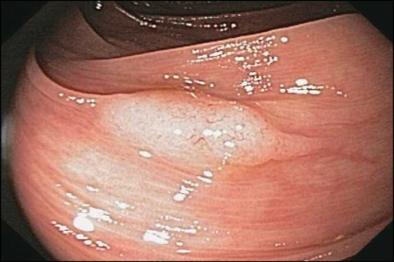
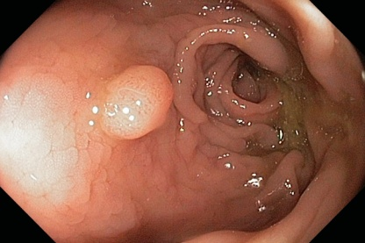
SSA
BRAF
MSI
CIMP-H
MVHP
Wnt?
P13K-AKT ?
MLH1 methylation
MGMT
Others
BRAF
KRAS
MLH1MGMT
Others
BRAF
MSS
CIMP-H
p16INK4a
IGFBP7
others
Alterations in the
CIMP
MAPK pathway
KRAS
BRAF
MGMT
KRAS
MSS
CIMP-L
Wnt?
P13K-AKT ?
GCHP
TSA
Inhibition
Activation
Evolution

Slide 6
52% proximal SAC
15% distal SAC
SSA
TSA
Caucasians
Older women
CDX-2
BRAF +
Peritoneal involvement
CIMP-H
Stage III (T4, N2)
High grade
Liver and nodal involvement (MSS>>>MSI)
African-Americans
Women
KRAS +
CIMP-L
MSS/MSI-L
Low grade
33% rectum
TSA

