Slide 1
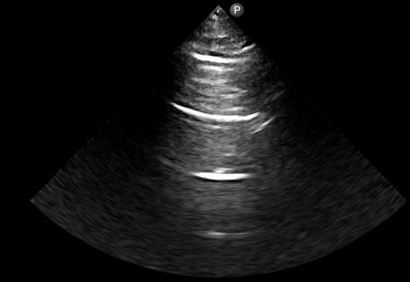
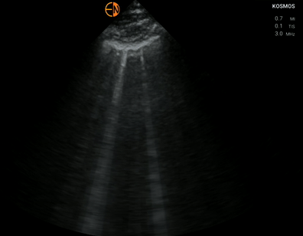
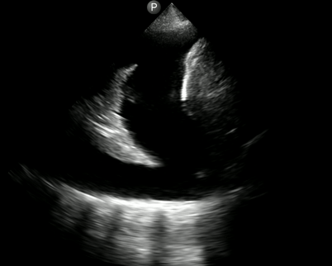
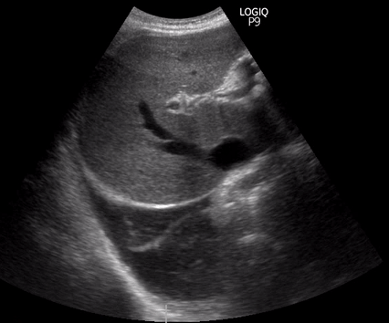
A
B
C
D
ANTERIOR
RIGHT
LEFT
HEAD
FEET
Liver
Liver
POSTERIOR
*
Atelectatic lung
IVC
*
Notes:
FIGURE 1

Slide 4
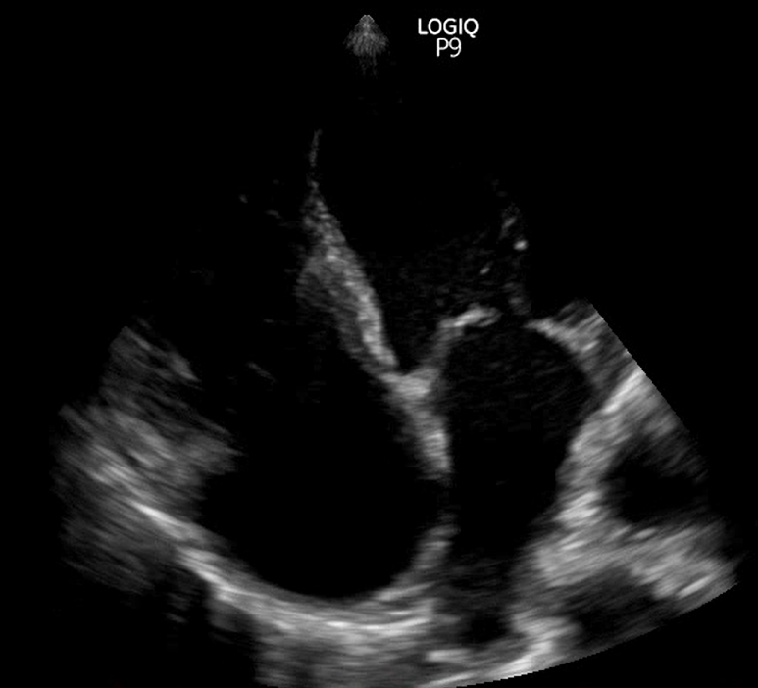
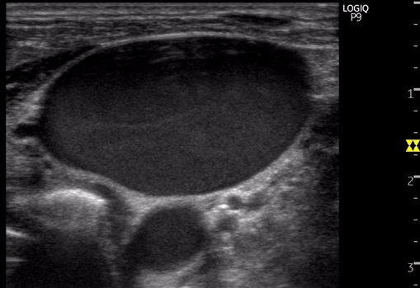
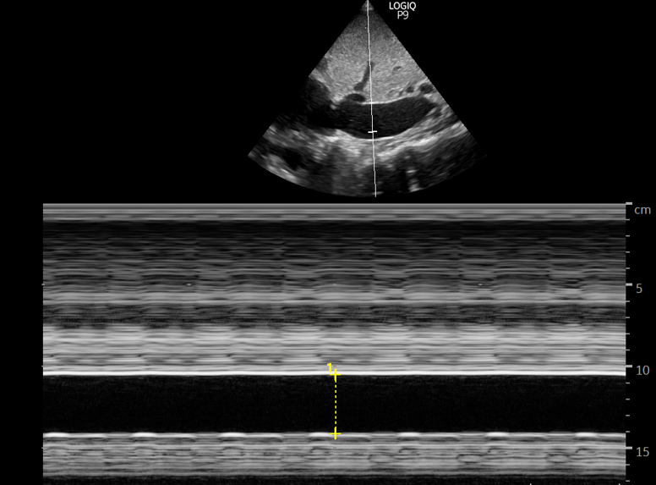
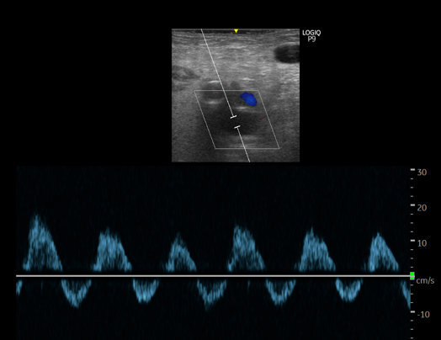
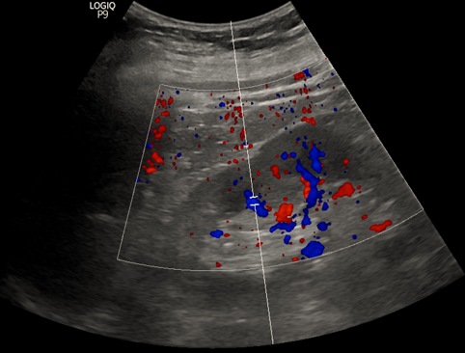
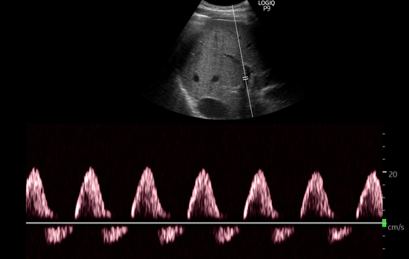
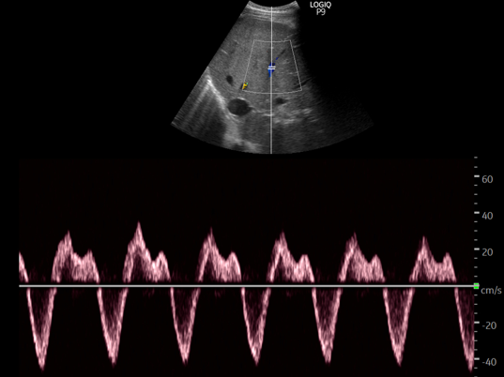
LV
RV
IJV
LA
RA
CA
IVC
3.4 cm
S
S
D
D
D
D
Femoral vein
Intrarenal vein
Portal vein
Hepatic vein
Notes:
FIGURE 4

