Slide 1
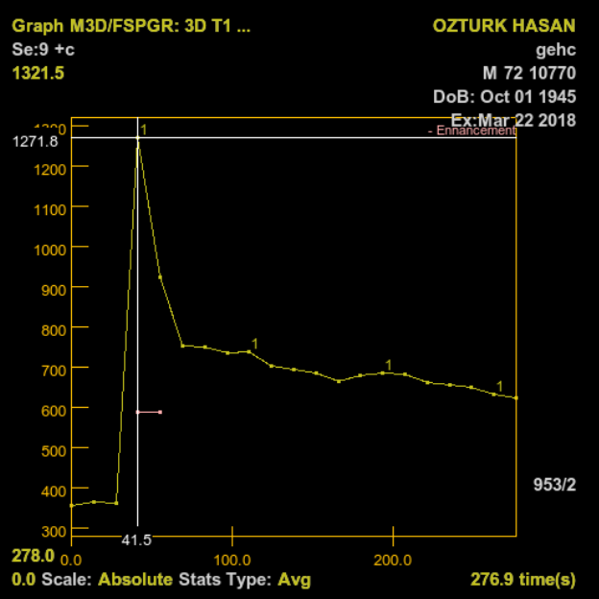
A
B
C
D
1
ADC: 0.8x10⁻³ mm²/s
E
F
G
H
Ktrans: 0.617
Kep: 6.438
Ve: 0.073
DOI: Copyright ©The Author(s) 2022.
Notes:
Figure 1

Slide 2
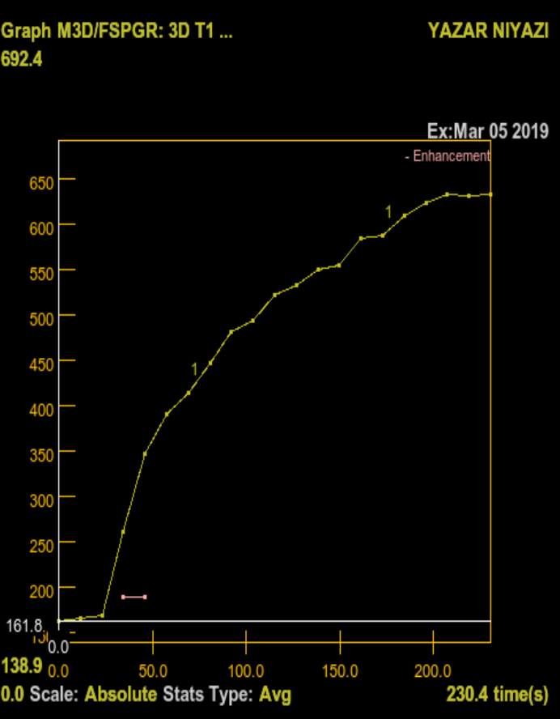
A
B
C
D
2
ADC: 1.7x10⁻³ mm²/s
E
F
G
H
Ktrans: 0.211
Kep: 0.383
Ve: 0.593
DOI: Copyright ©The Author(s) 2022.
Notes:
Figure 2

Slide 3
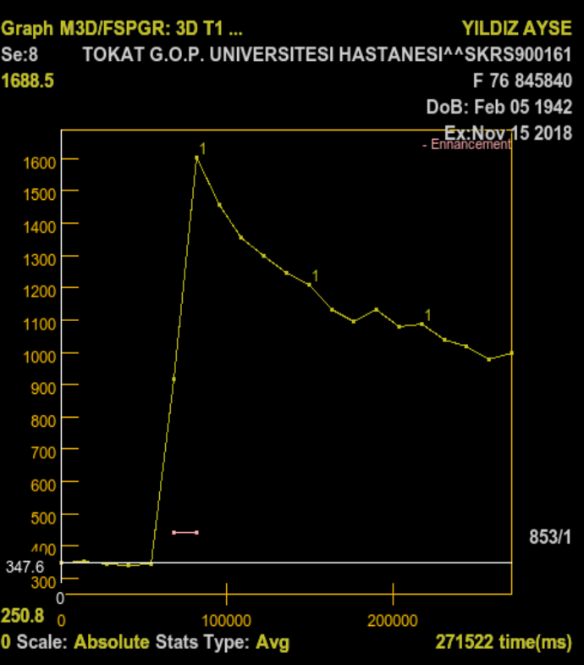
A
B
C
D
3
ADC: 0.6x10⁻³ mm²/s
E
F
G
H
Ktrans: 1.058
Kep: 3.391
Ve: 0.356
DOI: Copyright ©The Author(s) 2022.
Notes:
Figure 3

Slide 4
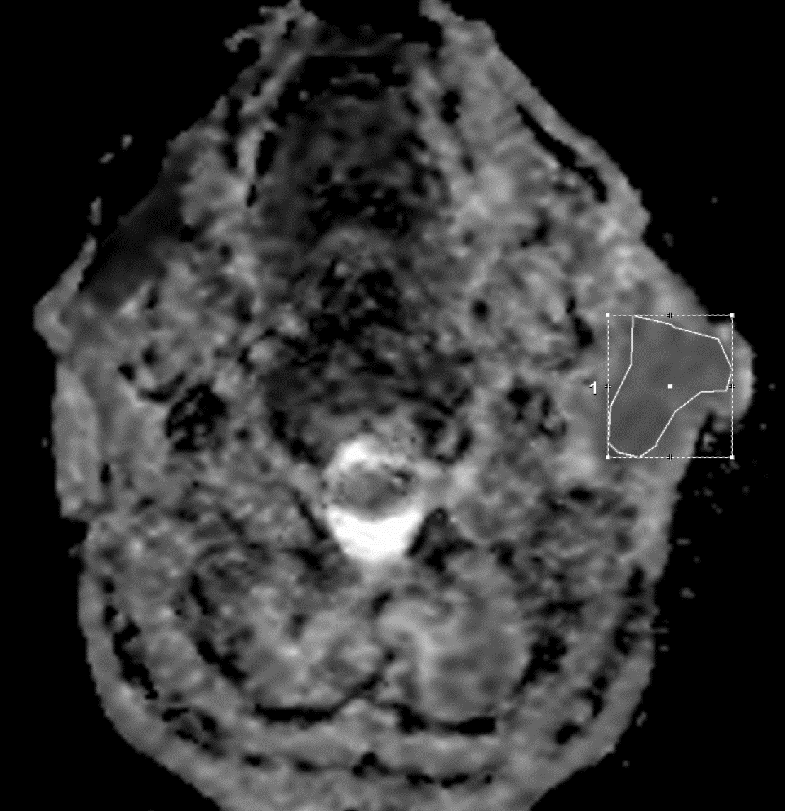
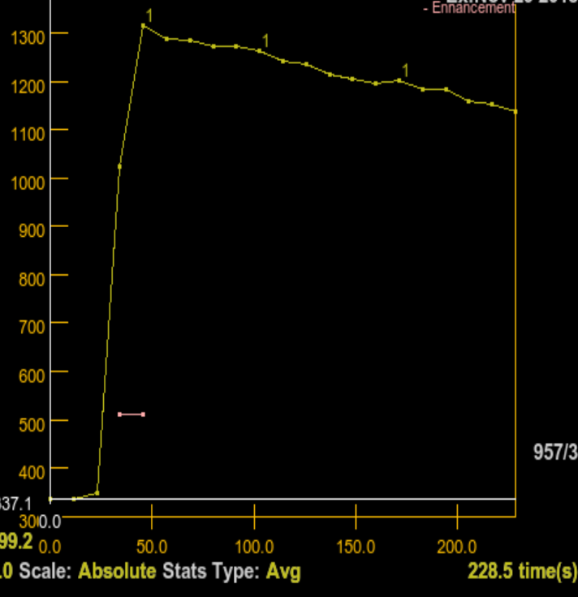
A
B
C
D
ADC: 1.1x10⁻³ mm²/s
E
F
G
H
Ktrans: 0.993
Kep: 1.659
Ve: 0.612
DOI: Copyright ©The Author(s) 2022.
Notes:
Figure 4

