Slide 1
uncropped membranes of Fig 1A
uncropped membranes of Fig 1C
1
5
GRP78
FAM134B
2
6
CNX
ATG12
3
7
CHOP
LC3
4
8
β-actin
β-actin
Copyright ©The Author(s) 2022

Slide 2
uncropped membranes of Fig 1E
1
FAM134B
2
CNX
3
LC3
Copyright ©The Author(s) 2022

Slide 3
uncropped membranes of Fig 5A
1
FAM134B
2
β-actin
Copyright ©The Author(s) 2022

Slide 4
uncropped membranes of Fig 5C
1
FAM134B
2
β-actin
Copyright ©The Author(s) 2022

Slide 5
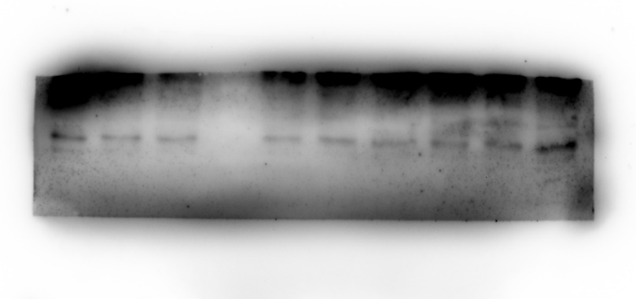
uncropped membranes of Fig 5E
1
Cyt C
2
Cleaved Caspase-3
3
β-actin
Copyright ©The Author(s) 2022

Slide 6
0 h
3 h
6 h
12 h
24 h
48 h
ER-Tracker
Lyso-Tracker
Figure 2
Merge
0 h
3 h
6 h
12 h
24 h
48 h
Rhod-2 AM
Figure 3
Mito-Tracker
Merge
Copyright ©The Author(s) 2022

Slide 7
FIG4 A
FSC-SSC
FITC-PI
blank control
FITC-Annexin V
PI
Copyright ©The Author(s) 2022

Slide 8
FIG4 A
FSC-SSC
FITC-PI
FSC-SSC
FITC-PI
0 h
12 h
3 h
24 h
6 h
48 h
Copyright ©The Author(s) 2022

