Slide 1
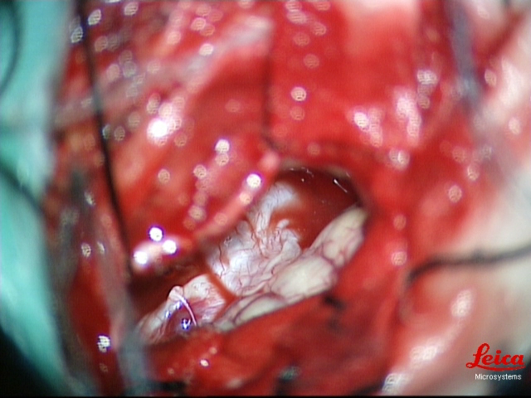
Supplementary Figure1 photographical images of the patient During operation. Red arrow indicates theabscess wall.Green arrows indicate the normal cerebral tissue.

