Slide 1
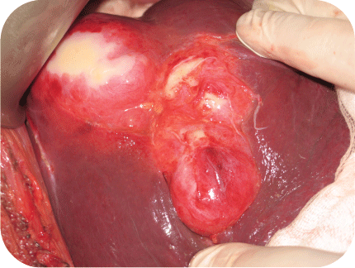
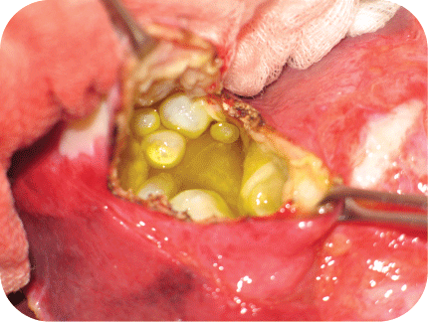
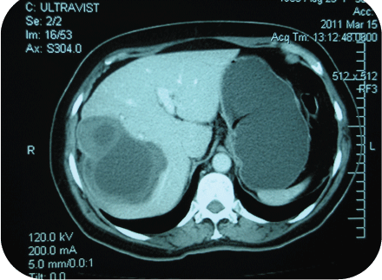
Figure 1. Induction of cystic echinococcosis
EMBRIONATED EGGS
In feces of end host
Th1 →IFN-γ and IL-12 (Rigano et al., 1999; Siracusano et al.,2012)
ONCOSPHERES
hatches and penetrates intestinal wall of intermediate host
Metamorphosis ; IgE and basophils (Aceti et al.,1990; 1992)
Th2: IL-4; IL-5; IL-10 ; TGFβ- (Amri et al. 2009) - susceptible to the parasite
METACESTODES
growth infiltratively
DC underwent apoptosis and survived DC failed to mature (Evert et al., 2010)
Consumption of complement (Diaz et al.,1995; Ferreira et al.,1995)
Induction of CD4+CD25+Foxp3+ (Bennett et al., 2001) → fulfill an important role for parasite survival
LIVER CYST
B
C
D
A
ANTIGEN B (AgB) FROM HYDATIC CIST FLUID (HCF) INFLUENCE PARASITE SURVIVAL
a) Suppresses human neutrophil chemotaxis (Shepherd et al., 1999; Rigano et al., 2001).
b) Inhibits lipid detoxification & metabolism by fatty acid binding property (Chemale et al., 2001; 2005).
c) Modulates Dendritic cells (DC) maturation (Ortona et al.,2001)
d) Influences innate & adaptive host immunity
e) Suppresses IL-12p70, but not and IL-6 (Zhang & McManus, 2003)
f) Increases IL-10→Th2 (Amri et al., 2009).
g) Increases IL-10→Th2 (Amri et al., 2009).
h) Inducts a new heat shock protein- HSP70 (Ortona et al.,2003)
Protoscolex (PSC)
from cyst
→ 12 kDa – serin protease inhibitor with strong chemoatractant activity
→ Activate PMN-Le, Ne, basophils and mast cells to PSC inducing inflammation
→ Allowing PSC to develop into secondary cyst (Rigano et al., 1996; Karavia et al., 1996).
AgB:
AgB:
→ Activate alternative complement pathways (Ferreira et al., 1996)
→ ˃IgG and Ag-Ab interactions may induce apoptosis
→ Cyst infertility (Peredes et al., 2011)
→ Activate CD8+T lymphocytes (Kizaki et al., 1993)
→ Upregulate maturation markers of dendriric cells (DC) (Jenne et al., 2001)

Slide 2
Figure 2. Subversive strategies of E. granulosus
PHYSICAL BARRIER
IMMUNE EVASION
Parasitic IgG4 can inhibit IgE mediated degranulation of effector cells and by reducing of allergic pathology, prolonging the parasite survival (Yazdanbachsh et al., 2002).
IgG4 and IgE to EA21 and ciclophilin (allergen) also can reduce severe pathology (Ortona et al., 2002).
EgAgs: AgB; Egteg; EgEF-1β/δ; Eg2ASP70 (Ortona et al., 2001; 2002; 2003)
AgB: modulate DC maturation and suprress Il-12p70, but not IL-6 (Elliot et al.,2009)
EgEF-1β/δ; Eg2ASP70: as allergic tarrgets prolonging parasite survival (Ortona et al., 2001; 2002; 2003).
˃ IL-10 by activation of B cells favor polarizing Th phenotype (Baz et al., 2006)
Th1 and Th2 are not
precommited phenotype
(Jankovic et al., 2006)
<Th1
˃ Th2
They are endpoints of multistep differentiation
process acquiring different cytokine secretion
(Amri et al., 2009).
SOURCE
ALBENDASOLE TREATMENT
INACTIVE CYST
ACTIVE CYST
PBMC
Th1
Th1
Mixed clone: Th1; Th2 & Th0
Cytokines:
˃ IL-12p40
˃ IFN- γ
˃ TNF-α
˃ IFN-γ ˂ IL-4
˃ TNF-α ˂ IL-10
but not IL-6
˃ IL-10
˃ IL-4
˃TGFβ
(Rigano et al., 1999; 2004; 2007)
DC - PARASITE INTERACTION
Triggering parasite-induced immunity by:
• Influence Th1 to Th2 shift
• DC fail to mature in the presence of crude non-fractional parasite in intermediate host.‚
(Vuiton et al., 2010; Jankovic et al., 2006; Sher et al., 2003; Kanan & Chain, 2006).

Slide 3
Figure 3. E. granulosus Induced Autoimmunity
DEFECTIVE ELIMINATION/CONTROL
OF SELF-REACTIVE LYMPHOCYTES (LYS)
T-EFFECTOR LYS
imbalance
between
T-REGULATORY LYS
˃ IL-17
˃ IL-23
˃ Foxp3+
˃ TGFβ-1
˃ inflammatory capacity of Th17
(Gorechi et al., 2010)
Th17/ Treg balance
(Goris et al., 2012;
Ota et al., 1990;
Liblou et al., 1991;
Rosenblum et al., 2015)
control of inflammation
E. granulosus evasion
GENETIC SUSCEPTIBILITY TO HOST AUTOIMMUNITY
Polymorphism of multiple genes→ fulminant autoimmunity
IL-23→proinflammatory capacyty of Th17 (Rosenblum et al., 2015)
genetic polymorphism
of IL-23 & IL-17A
by monoclonal Ab-p40
is detected in:
Behcet’s disease
Ulcerative colitis
Crohn’s disease
Psoriasis
Ankylosing spondilitis
MONOGENIC
AUTOIMMUNE
DISEASES:
Autoimmune Polyendocrine Syndrome (APS)
ImmunodisregulationPolyendocrinopathy
Enteropathy X-linked Syndrome (IPEX)
MUTATION OF: AIRE
FOXP3
FAS LIGAND/SIGNALING
MEDIATES APPOPTOTIC
PATHWAYS
Lymphoproliferative Syndrome
Lymphadenopathy
Splenomegaly
Autoimmune Cytopenia
(Elliot et al., 2009; Vanderbroeck K. 2012)
(Finish-German 1997; Benett et al.,2001)
(Fisher et al., 1995)
ENVIRONMENTAL TRIGGERS
Epitope spreading
Antigenic complementary
Excesive innate/pattern recognition receptor activation
DEFECTIVE REGULATION
< Number of T-regulatory cells, and resistance of Teffector cells—→ autoimmune response
More mechanisms in the human host are operating to permit evasion of E. granulosus:
EPITOPE SPREADING
1) Autoimmune hemolytic anemia-
due to IgM cold agglutination with anti-1 specificity
2) Parasite Ags to cross with humans Ers (Girelli et al, 1993).
3) Anti- neutrophil antibodies
Anti-nuclear Ab
Anti-myeloproteinase
Anti-smoot muscle
Anti-lactopherin;
Anti-phospholipid
Anti-cardiolipin
Anti-MHC-I
Anti-MHC-II
(Aslan et al., 2009; Romani, 2008; Pordeus et al., 2008)
MORE SELF AGS DRIVING THE REACTION
(De Rosa et al., 2 001)
INFLAMMATORY MICROENVIRONMENT
MORE INFLAMMATORY CELL RECRUITE
INFLAMMATORY LOOP
(Banchreau & Pascual, 2006)
Contribute to impairment of immune reactions in the intermediate human host cystic echinococcosis (CE),
due to antigenic mimicry (Romani, 2008).
TISSSUE DAMAGE

