Slide 1
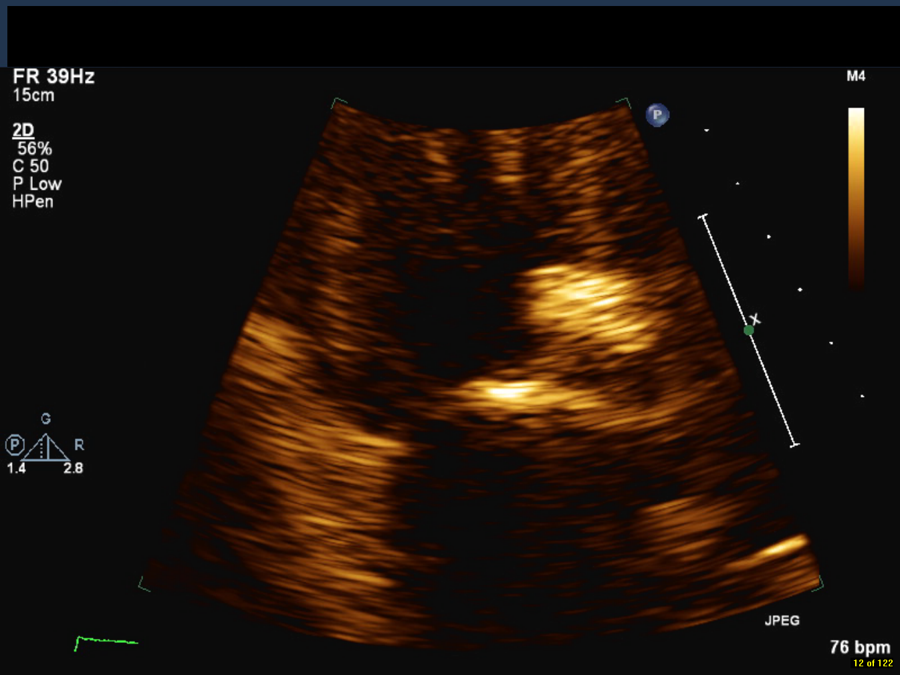
Figure 1. Severe calcification of proximal aorta and aortic leaflets (arrows) resulting in moderate aortic regurgitation and stenosis.

Slide 2
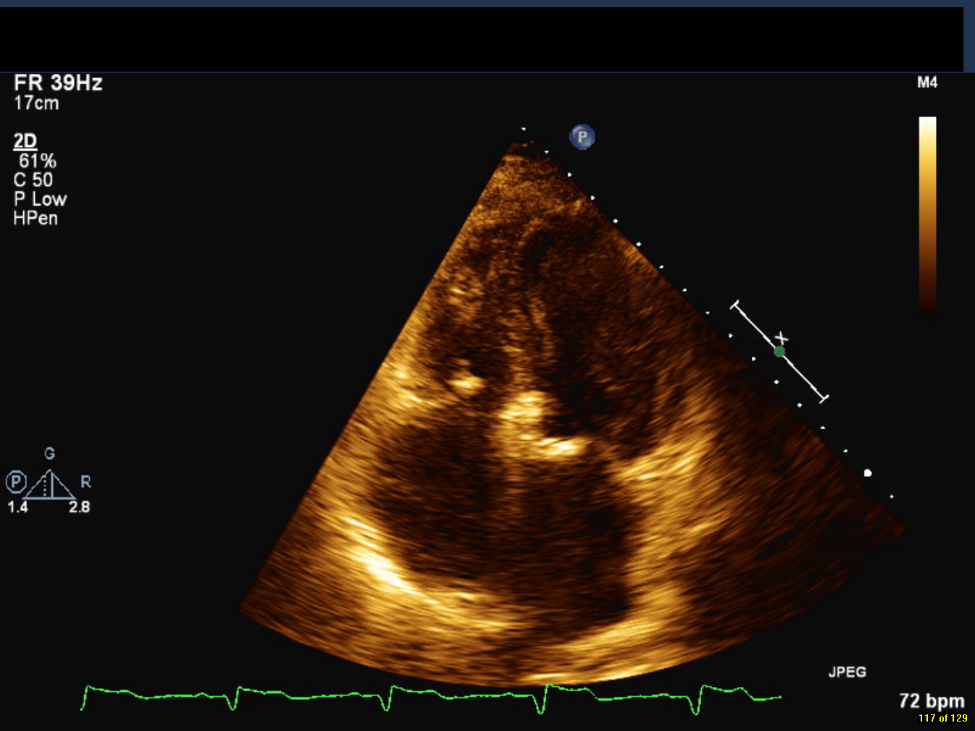
Figure 2. Apical four chamber view of mitral annular calcification (arrow).

Slide 3
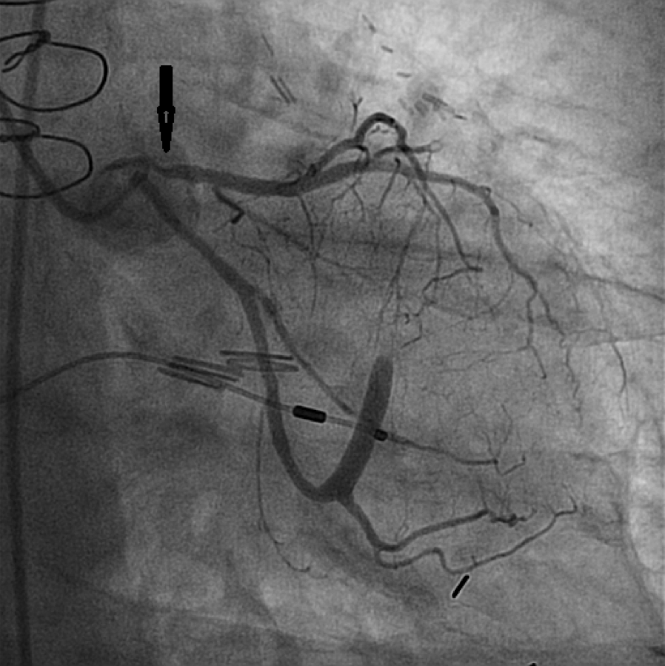
Figure 3. Severe proximal LAD stenosis (arrow).

Slide 4
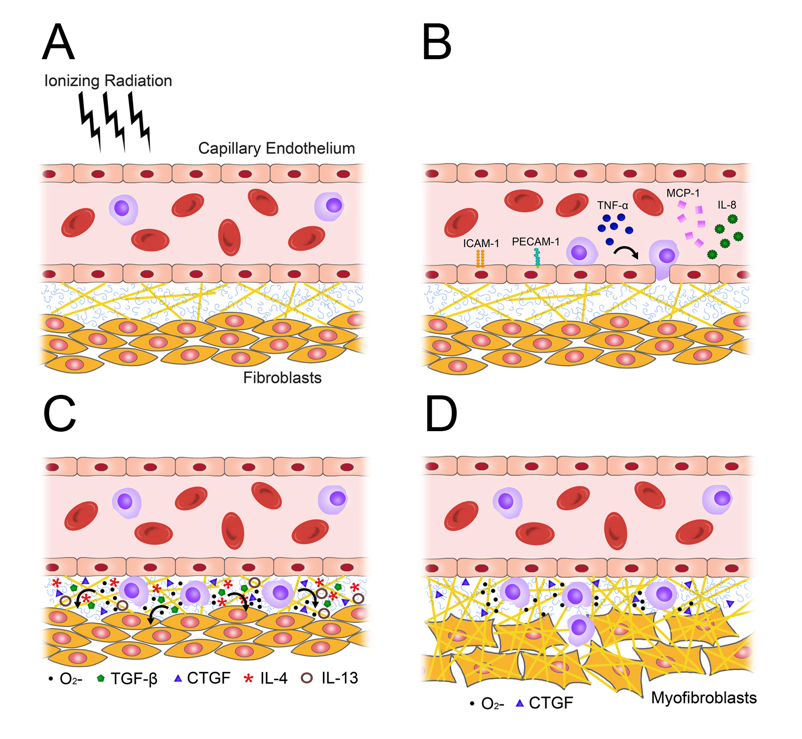
Figure 4. Radiation injury and the transition from acute inflammation to chronic fibrosis, as mediated by pro-fibrotic cytokines and reactive oxygen species. O₂⁻ = reactive oxygen species; TNF-alpha = tumor necrosis factor-alpha; Monocyte chemotactic protein-1; CTGF = connective tissue growth factor

Slide 5
Figure 5. Proposed algorithm for cardio-oncologic screening following mediastinal radiotherapy.

